Slide 1
Moving from Special Measures to Good and beyond.
London Ambulance Service
11th June 2018

Slide 2
Context
LAS put into special measures and rated inadequate 2015-16
Changes in leadership over 2 years
Different approaches:
High risk focused actions : Year 1
Focus over year 2 – business as usual, rapid improvement in targeted domains, embedding change, building capacity and capability

Slide 3
Our Care Quality Journey since 2015-18
 | Safe | Caring | Effective | Responsive | Well Led
Outstanding
Good
Requires Improvement
Inadequate
2017/18
2018
2015
2017
2018
2018
2017
2015/17
2015/17
2017
2015
2015

Slide 4
CQC Approach 2016-17: Year 1
Funding from commissioners/NHSI (£10m, medicines management and Make Ready)
Task focused approach from CQC actions
Monitoring via QIP Programme Board: corporate and operational focus- > 100+ actions
Chair and Chief Executive and Board monitoring
Communications strategy
Focus on safety and medicines management due to Section 29a Warning Notice

Slide 5
Focus on Medicines Management

Slide 6
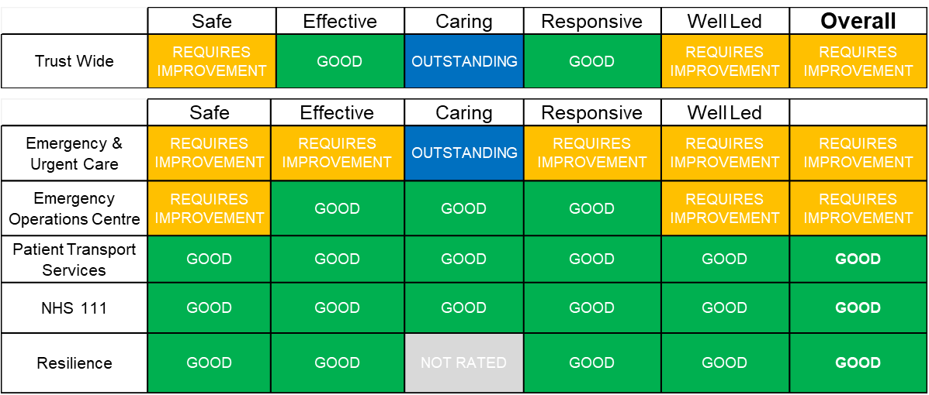
February 2017 – Moved to Requires Improvement, Special Measures retained

Slide 7
Lessons learned from 2016-17
Governance and risk systems/processes under-developed
Silo working in operational and corporate teams
Inconsistency and variation across operational teams/sectors
Monitoring not built into quality assurance processes – no front line to Board quality monitoring
Duplicate plans across corporate teams
Inability to easily access data and information
No QI methodology, limited QI capacity and capability
Variation in capacity and capability across directorates –Systems and processes not ‘business as usual’ – focused delivery for inspection

Slide 8
Our Approach 2017-18
Reviewed all of the current Trust action plans and completed a gap analysis against the newly defined KLOE’s
Compiled a single plan for the Trust, combining all quality deliverables aligned within the 2017/18 Business Plan, Well Led analysis and CQC Action Plan into one Quality Improvement Plan
This new Improvement Plan incorporated both impact and progression KPIs, all within a clear reporting framework via the newly created Programme Board
Introduced Agile and Burn Down improvement techniques- increased focus and pace of change to enable to ‘get to good’
Also developed a framework to ensure the Trust was prepared and ready for the next CQC inspection
In addition to the re-structuring and systems and process changes, we ensured that the Trust had sustainable quality improvement and assurance mechanisms
Ethos of ‘business as usual’ and sustainability

Slide 9
Establishing the QIP
Single view maintained through the Quality Improvement Plan (which included the new QIP, Well Led Action Plan and CQC Action Plan)
Executive Director accountable for projects within their directorate
In-flight projects continued with current delivery method providing achieved before mid-December
Agile approach to be used for all other deliveries using Scrum/Burn Down technique to deliver by mid-December
Governance and oversight provided through the QIP Programme Board which was fortnightly via ELT meetings :exception reporting
Quality Improvement Plan was a subset of the Trust Business Plan and contributes to the success of the business plan and strategic objectives, resources approved.

Slide 10
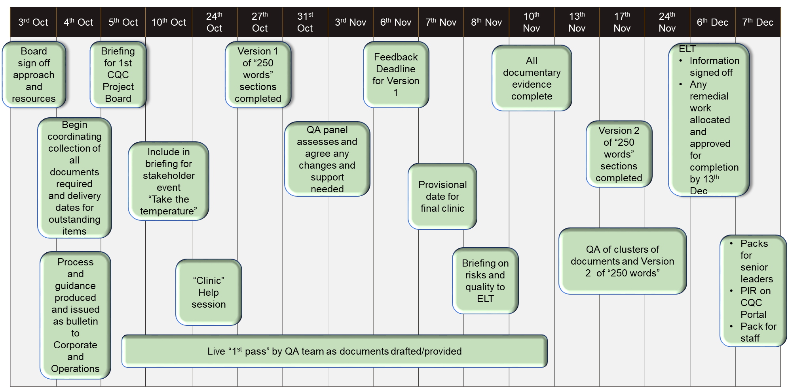
PIR Schedule : proactive data collection

Slide 11
Quality Assurance Visits
Purpose is to enable stations to test if they meet the Key Lines of Enquiry (KLOE) set out by the CQC
Carried out every quarter and included:
An observational review of premises and facilities
A review of key evidence
A discussion with staff
The visits were planned to be a regular ‘business as usual’ activity
All evidence uploaded to Health Assure
All monitoring of progress ( alongside other performance indicators0 as part of newly developed quality assurance framework
– Clinical governance framework review
- Frontline to Board reporting and Performance Management
- Implement Health Assure – monitor variation and compliance

Slide 12
Risk Management Programme 2017 / 2018 - HealthAssure
Online CQC reporting, self-assessment and evidence gathering software to provide assurance against the fundamental standards, Key Lines of Enquiry and clinical review tools.
Launch date 26 January 2018 following a 4 week window for linking of evidence and actions to the CQC Domains and Key Lines Of Enquiry
New X drive location for policy links
Additional documentation and pointers for KLOEs and what is applicable to LAS will be configured
New CAS module to support with the management and dissemination of the Department of Health’s Central Alerts to key stakeholders across the Trust
140 colleagues trained to date – additional training dates to be released
Floor walking, champion training and support for staff

Slide 13
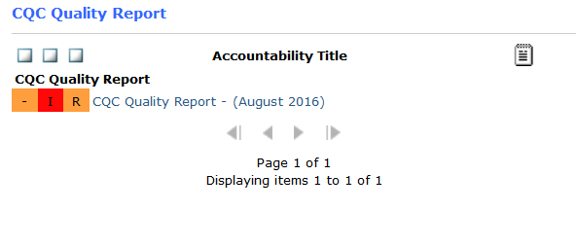
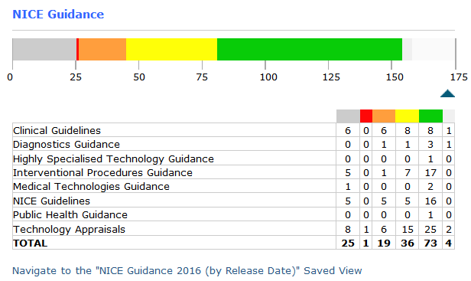
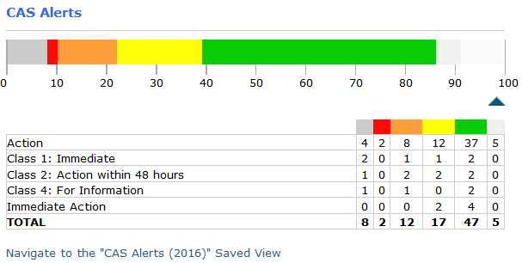
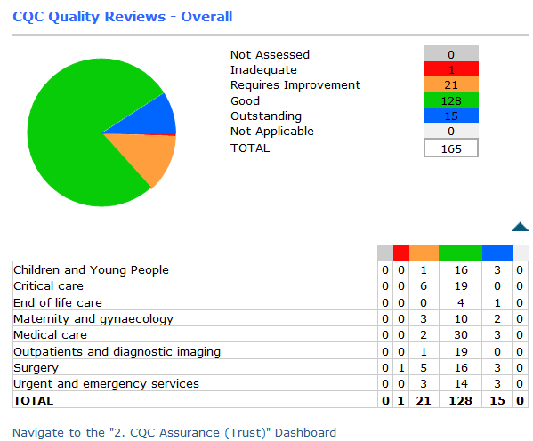
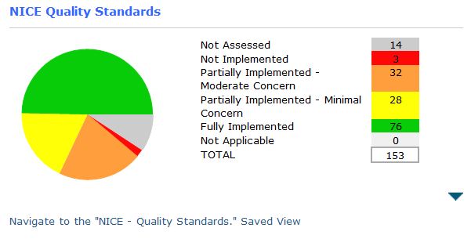
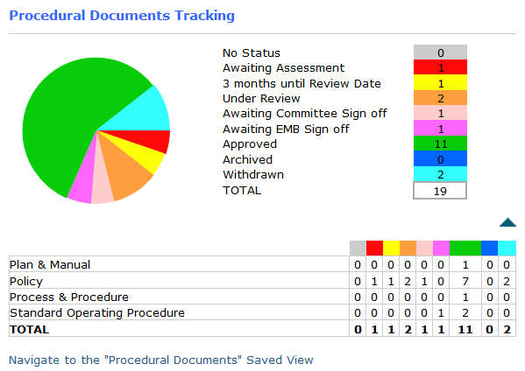
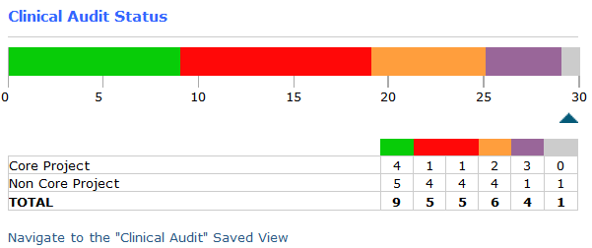
Integrated Assurance Dashboard
Reporting views – supported by Audit Apps and automatic downloads to system

Slide 14
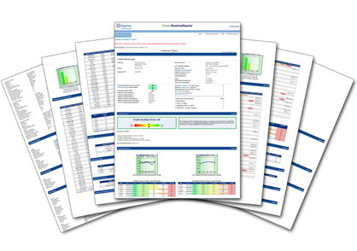
Risk Management Programme 2017 / 2018 – Incidents
You said - we did, user
feedback and engagement
sessions on system design, configuration process and workflow
Feedback email functionality
is now built into the incident workflow
Revamped incident classification and mapped to the NRLS - continue to reflect LAS incidents
Developing an e-learning induction training package for all staff on incident reporting and manager investigations
Weekly overdue incidents and
unapproved risks report Integrating Datix
shared with senior managers - with Tranman to
resulting in a continued overall streamline the processing
reduction of overdue incidents of vehicle accidents /
damage
Duty of Candour stage 1 now appears
on the reporting form
Removed all existing paper incident forms
Introduction of a Quality Checking process for all
incidents to review the data quality and NRLS
requirements

Slide 15
Risk Management Programme 2017 / 2018 - Risks
Redesign and Reconfiguration of Risk Register
in line with risk management ‘best practice’
Introduction of a ‘back to basics’ Risk Awareness
course for all risk owners, risk leads
and risk coordinators New Datix Risk system training
on the revised escalation process
Developing a ‘tool kit’ - easy to use for risk staff
Developing risk e-learning packages for training
Training materials ready for relaunch
‘station to board’ and vice versa
New Datix Risk system training on the revised
escalation process ‘station to board’ and vice versa

Slide 16
Overview of Agile Process:
Ensuring we ‘Get to Good’

Slide 17
Overview of Agile Key Roles
ROLES ARTIFACTS MEETINGS
PROCESS
Product owner
Accountable for ‘business’ decisions - empowered
Product backlog The tasks we must get done before
end of November
Sprint Planning
The initial meeting to agree the backlog and timings
Excellent Good Averag ^{e}Poor
Excellen tGood Aver aPgoeor
Product
Backlog
Scrum master
Accountable for pace and clearing blockages
Sprint Goal The desired outcome of the week
Daily Scrum
A 15 - 20 minute meeting at a set time to talk progress and blockers.
R e p e a t
Sprint N (Days)
Daily Scrum
Sprint Backlog
The tasks we must
get done this week
Sprint Backlog
Team members Accountable for delivery and expertise
Sprint Review
A look back at what has been achieved, did it meet expectations
Blocks List
A list of issues that need to be cleared
Daily
Work Increment
Stakeholders
Informed and ‘show cased’
Excellent Good Averag ^{e}Poor
Excellent
Blocks List
Good
Avera ge
Poor
Sprint Retrospective
A review at the end of the ‘release’
Increments What have we achieved in terms of the product backlog
Sprint Revie w
Sprint Retrospective

Slide 18
Overview of Agile Process and roles
Sprint Planning Meeting
Daily Cycle
PREPARATION
Agreement of what
Vision and expectations
Initial Product Backlog
Initial Release Plan
Stakeholder buy-in
Define & assemble
Team
Update Product Backlog
AGILE BURN DOWN PROCESS
Increment
Scrum master
Sprint retrospective
Sprint Review
Product owner
Our focus on what we are going to do before mid-December
ROLES
Team members
Stakeholders
Users

Slide 19
Agile Burn Down Chart illustration only
123 Secure storage of COSHH products
185
Derm OPD Concordia staff uniform compliance 37
Excess Zopliclone 79
Dress Code compliance including nail varnish 211
No FGM or Prevent Policy 119
ED fire exit open due to department temperature 121
Compliance of Health & Social Care Act
3 Gaps in EOLC care plans
Burndown against agreed targets
Name badges for all staff 209
Update Team of the Month board 202
Secure IV fluid storage 70
Variable pharmacy support to wards 106
Storage of IV dilutents 64
Mislabelled drugs patients own as stock
Poorly written drug charts 58
Blocked fire exit ED 12
1Li6m1ited sharing of learning from incidents 14
Review and replace CD drug books 46
Task/time tracked daily/weekly
Out of date PAT testing 10
Limited feedback to staff about incidents 6
Congested theatre flow delaying #NOF cases 146
No medical EoLC lead
69
Minors Area ED broken cupboard
43
Limited knowledge about Medical staffing at incidents, themes and night 51
trends 22
Omitted drug doses not followed up 53
Missing ceiling tiles Surgical OPD
217
Limited use of up to date student induction pack 112
Staff reporting dangerous staffing levels 5
Limited use of safeguarding processes to support staff on the front line 55
Consent - staff understanding of who can take it and supporting documentation 48
Product Backlog (numbers)
Unlocked cleaners cupboards 213
Gaps in staff knowledge about whistleblowing processes 164
Drugs stored in cars overnight 201
No CO2 monitoring on Pharmacy not
Variations
LMA airways 32
accepting returns
127
No summary of #NOF pathway 93
Expiry date of 02 cylinders not on Resuscitation Trolley checklist 23
Discharge delays for
#NOF patients 137
Gundulph: trailing cables at nurses station 318
Drugs out of original packaging 35
Variable appraisal rates 27
Emergency Drug Cupboard medication not removed 118
No chaplaincy leaflet in circulation 158
Structure and content of site meetings 71
Safeguarding/DoLs/ MCA - understanding and documentation compliance 20
Out of date ward stock list 38
Not all wards receiving daily pharmacy visit 342
Managed via daily stand ups
Retrospective reviews ensure quality
Over 130 actions completed within 3 month time period
Evidence of completion and on-going monitoring within governance processes
Out of date BNFs 11
Limited use of lone worker devices in Chaplaincy 131
Staff reporting 1:13
staff ratios 15
ET tubes removed from packaging and pre-cut in DSU 74
Medical Outliers on T&O not covered by medical consultant 39
Allergies not recorded on drug charts 400
No up to date local IV injectables guide on ward 13
Limited Mortuary capacity and flow 44
Community Midwifery folder missing PGDs 45
Staff awareness of Staff discouraged to
Side room door not closed when patient in isolation 99
Excess midazolam on Milton 208
departmental risks ED develop
Pharmacy Risk Register 2
Liverpool Care Pathway leaflets on ward 68
Variable use of gloves and gowns 76
42
professionally 77
Review IP&C Governance arrangementsWard to Board 19
Bully behaviour reported 40
POCU broken drug door hinge 65
Poor prescribing practice 130
No ward controlled drug stock list 29
Support to prepare EOLC Lead for CQC 218
Deteriorating Patient not featured in Site Meetings 25
Gaps in DNACPR forms including documenting discussions 54
Frequency of medical Noisy doctor
Pharmacy review of drug charts and medicines reconciliation 95
reviews of medcial outliers 24
handover environment 49
No controlled drug destruction kit on POCU 216
Not all areas challenge visitors on ID and reason for visit 177
Staff reporting staffing levels worse 73
Mental health pathway Out of Hours access
Broken blinds in clinical areas 346
Drug chart legibility
401
delays 154
to management support 60
Doctors unware of how to access Pharmacy OOHs 83
Out of date workplace Gaps in EoLC training
Bullying culture reported 63
CD cupboard not large enough - Phoenix 125
Unsafe storage of Missing weights on
(ward) risk assessments for staff 36
medical gas cylinders drug charts 34
Out of date drugs 212
9
57
Entrances to wards not always secure 91
Limited involvement of Spiritual Care in End
Variable clinical skill levels of junior
Gundulph: cracked tiles and sink by
Leaking air-con in O2 prescribing 61
Imaging department
of Life Care plans 157 doctors 31
nursing station 328 116
Out of date ward stock lists
214
Radios on at night on wards 215
Review dosage on End of Life Care Algorithm 28
Poor patient flow ED
16
Unsecured patient notes 75
Variable compliance with Stat & Mand training 33
Recording of NEW S scores escalation actions 189
Gaps in ward safety checklists 59
Variable understanding Areas of high
Unlabelled sedation Out of Hours x-ray
Completion of NEW S Scores 192
of Duty of Candour
and documentation 18
stress/low morale 56 drugs in syringes 7 cover limited,
Overfilled drug fridges 107
Ice machine in ED plaster room missing label 'not for human consumption 47
Complaints backlog (Must Do Should Do) 30
High temperatures in Clinic Rooms 8
ED sluice cupboard door broken 321
delaying ED & Theatre 117
Staff understanding of escalation pathway to Critical Care
Outreach Team 162
Limited visibility of senior nurses 72
0
Overfilled drug cupboards 88
No Help Alarm in ED waiting room 110
Unsafe Medical staff numbers due to gaps and sickness 1
Magpie - unsecured emergency drugs storage 80
Limited evidence of MCA documentation 103
Gaps in Sepsis boxes checks 50
Empty/Missing hand gels 333
1
2
3
Week
4
5
6
7

Slide 20
2017-18 CQC ratings: Good and removal from special measures

Slide 21
The Road to Outstanding: Embedding and sustaining change, reducing variation

Slide 22
Quality & Clinical Strategy/Improvement
Public and Patient Engagement
Road to Outstanding requires the role of an Orchestrator to be successful
LAS Quality Road to Outstanding
System/trust Leadership
Staff Engagement
Transformation & Strategy Delivery
Finance & Use of Resources

Slide 23
To make the journey from Good to Outstanding we will:
Continue to accept the challenge at Executive level and across the Trust
Prioritise our activity and allocated resources to achievement based on revised gap analysis
Manage delivery dependencies effectively
Fully deliver the Quality Improvement Plan – One Plan
Deliver on the Trust Strategy and Transformation Programmes which support the journey to Outstanding
Embed QI build capacity and capability
Continue to develop quality assurance processes
Leadership development, cultural change focus
LAS Quality Road to Outstanding

Slide 24
QI capability model for LAS – by staff group and role
Eventual
coverage
needed
Total
potential
Knowledge/skills needed
What’s involved
5,000
100%
Introduction to improvement & model for improvement
Identifying issues, developing & testing ideas
Measurement & variation
Introductory e-learning sessions (incl. at induction)
Online/self-accessed
400
100
Deeper understanding of improvement methods, variation and measurement
Goal-setting, leading and managing for improvement
Applied learning in teams over time linked to opportunities in real work
Access to coaching
Embedding into existing programmes
1. Front line staff
2. Clinical & operational leaders
n/a
50
As above, plus sophisticated enabling and coaching skills for individuals and teams
Applied learning and reflection in coaching teams supported by classroom programme
3. Coaches*
5. Experts
3
Direction-setting, “mood” & leading for improvement
Link to strategy and overall priorities; appreciation of systems; making variation and trends visible
Self-determined but typically includes: mix of individual/group; sessions with external experts; peer visits/”Board-to-Station”; quality assurance visits”
4. Exec &
Board
5. Experts
n/a
At least 50
Deep Dive methodology incl. of QI theory and science
Spread and implementation
Coaching/mentoring, teaching
Knowledge-generation and research
Careful objective-setting, review and planned (career) development
Applied learning through doing/coaching
Reflection and peer support
“Masterclasses”
Individually-tailored
* Coaches drawn from wide variety of professions and grades

Slide 25
Outline plan
Listen to staff and patients to determine priorities
Develop and tell our quality/QI narrative
Celebrate successes, showcasing existing work
Hold learning and awareness events
Visits to exemplar sites
Set up QI microsite (intranet and internet)
Develop a network of Quality Champions
Build will
Two key aims:
1. To accelerate delivery of the highest quality, best value care, and best staff experience across LAS by 2020
2. To embed continuous improvement into daily operations at LAS and to ensure best support to services across LAS
Have patient/carer involvement in all improvement work
Align service strategies, objectives, expectations and reporting with improvement aims; also align key trust initiatives, e.g., Quality Account, Clin Quality indicators,
Align individual goals/time with improvement aims (job plans, appraisal, prof. development, revalidation)
Develop informatics & analytics to support improvement
Create alignment and deploy infrastructure
Initial assessment of current capability, gaps & priorities
Recruit core QI team & establish internal secondments
Find and train experts
Build capability & capacity in different intensities & formats
Introductory training
In-depth longitudinal/applied training for teams
Develop coaches to support teams & initiatives
Executive and Board development
Embed in professional and leadership education
Build improvement capability and capacity
Apply, monitor assure
Through two main tracks – with rigorous measurement of quality and efficiency/quality assurance framework
Major trust initiatives, incl: Patient and staff /volunteers involvement programme; Strategy LAS Vision2020: QIP, service/pathway redesign
Local priorities: Each sector/station to work to a local QI objective

Slide 26
Continuing to build up a comprehensive processes and procedures: Level 4 or 5 maturity
Capability Maturity Model
It is characteristic of processes at this level that the focus is on continually improving performance through incremental and innovative changes – level 5
Level 5 Optimised
It is characteristic of processes at this level that using metrics and evidence, ways to adjust and adapt processes and performance across the organisation can be found – level 4
Level 4 Managed
LAS Quality Road to Outstanding
Level 3 Defined
It is characteristic of processes at this level that there are defined sets of documented standard processes established and subject to some degree of improvement over time – level 3
Level 2 Repeatable
It is characteristic of processes at this level that some are repeatable with consistent results. Process discipline is unlikely to be rigorous but where it exists it may help in times of stress – level 2
Level 1
Initial
It is characteristic of process at this level that they are typically undocumented and in a state of ‘dynamic’ change, tending to be driven ad hoc, uncontrolled and reactive in manner – level 1

Slide 27
We will also need to continue to ensure:
Systems & Processes are developed to fit recognised best practice
Culture, specifically, attitudes and behaviours are developed to support outstanding quality performance
Trust performance in its Use of Resources will have to be upper decile with no drop off in quality or patient care and experience
Makes use of digital technology and systems to ensure leading edge and innovative and patient focussed
Continue to embed ‘business as usual practices’ with on-going and continuous monitoring using measurement for improvement statistical techniques
LAS Quality Road to Outstanding

