Slide 1
Patient Engagement Update
Margaret Luce

Slide 2
Overview
Patient Engagement Strategy
Action Plan 2017-18
Looking back over last year
Activities since April 2017
Insight Project

Slide 3
Patient Engagement Strategy

Slide 4
Patient Engagement Strategy
Aims:
  Increasing meaningful engagement
  Increasing commitment across the Trust
  Ensuring the Trust is prepared to respond to changing requirements and priorities
Key priorities / action plan
Monitored by Patient & Public Involvement Group
Reports to Patient Experience & Feedback Group
Quality Oversight Committee and Trust Board

Slide 5
Action Plan 2017-18
Demonstrate actions taken by the Trust as a result of engagement
Provide support for patient engagement, e.g. in staff training
Provide support and training to staff volunteers
Co-ordinate actions arising from projects and activities, e.g. Insight Project, Blue Light Collaboration
Oversee developments in Community First Responder and co-responding schemes, defibrillators in public places and the GoodSam ‘app’

Slide 6
Looking back over last year
Insight Project
Survey of blind and partially-sighted people
Drop-in familiarisation days for staff
518 public events; 328 staff volunteers
Knife injury, legal highs and alcohol awareness
Safe Drive Stay Alive and other road safety activities
Careers events
Patients’ Forum / LAS Members / Partnership Reference Group

Slide 7
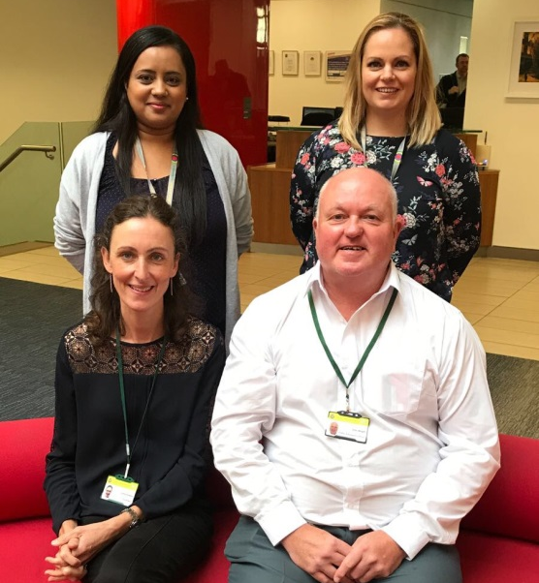
Public Education Officers
Sukhi Katy
Emma John

Slide 8
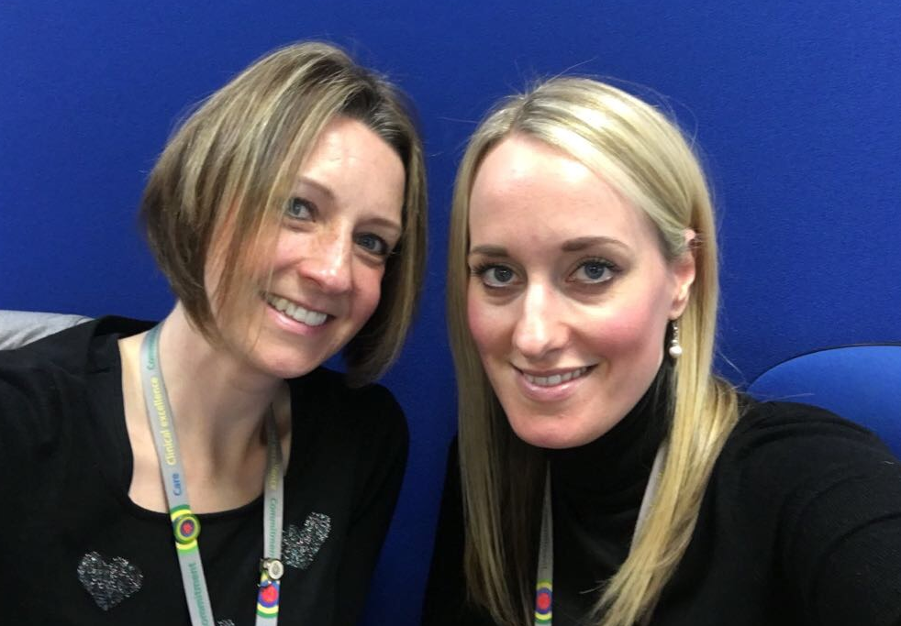
Co-ordinators
Ruth Lauren

Slide 9
Activities since April 2017
Partnership Reference Group - CQC / volunteering
Blue Light Collaboration pilot in Haringey schools
Insight Project: developments
Targeted careers events
Alcohol and legal highs
Acid attacks
277 events attended; 289 staff involved
1,217 staff on “interested” list
Public Education Staff Development Programme

Slide 10
Activities since April 2017
Schools (ranging from nursery to careers days)
Scouts, Brownies etc.
Junior Citizen Schemes
Basic Life Support training
Safe Drive, Stay Alive
Knife injury awareness
Blue Light Collaboration (including open days)
Older people’s groups
Learning disability groups

Slide 11
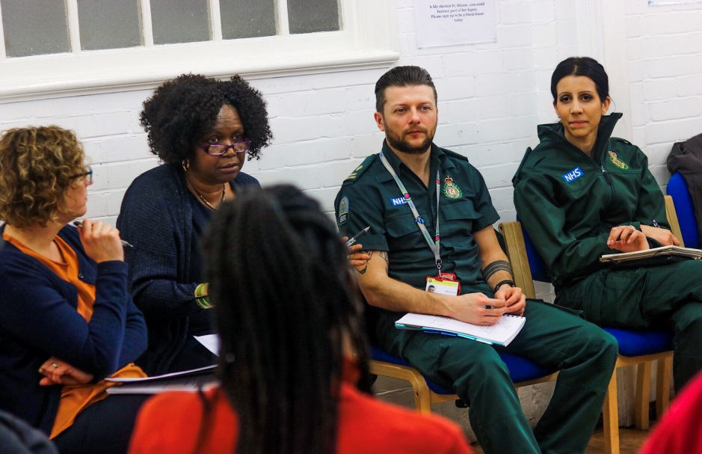
Insight Project
London Ambulance

Slide 12
Patient and Carer Communities
Three groups were identified and were willing to work with LAS to explore how services could be improved. These were:
The Lewisham Breathe Easy Group
The Merton Sickle Cell & Thalassaemia Group
The Oxleas Trust ResearchNet Peer Support Group

Slide 13
The Methodology
Patient and carer groups supported the arrangement of focus groups.
Groups were attended by patients, carers and LAS staff.
This model of co-production was an important feature of the work.
Each focus group was independently facilitated.
Focus groups were located on ‘home turf’ in community venues. where groups already meet.
Staff and service users were mixed in the room, avoiding ‘them’ and ‘us’.
A social element was included, with time for refreshments to share and speak informally as well as in the focus group set up.

Slide 14
Real People, Real Lives
During the course of the focus groups, participants shared their powerful and sometimes emotional experiences and stories.
To do this takes great courage, and we appreciate people being so generous with their time and energy.

Slide 15
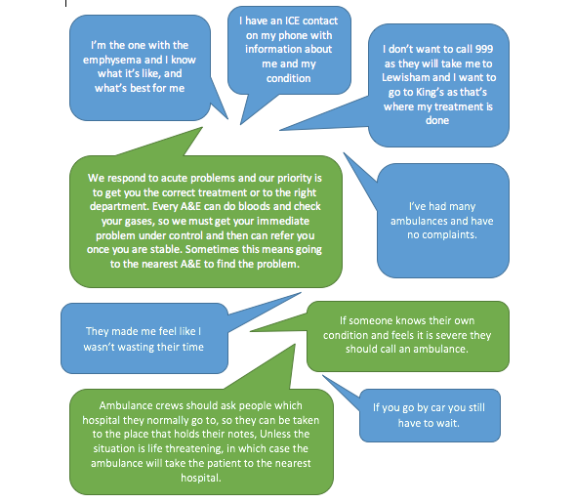
Respiratory Disease

Slide 16
Suggestions Included
Personal emergency plans | Improved communication
‘What to do in a crisis’ card | Using personal information cards
Knowing when to call an ambulance | Information about ’message in a bottle’ and ‘key safes’
How to communicate on the phone when you can’t speak | The use of Patient Specific Protocols
Information about what to expect when an ambulance arrives | Training for ambulance staff in what it feels like not to be able to breathe

Slide 17
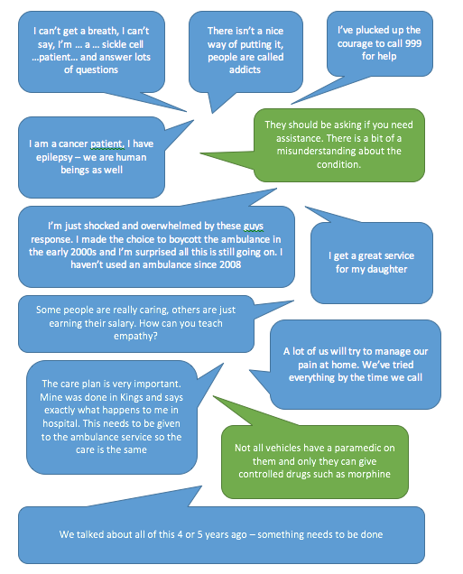
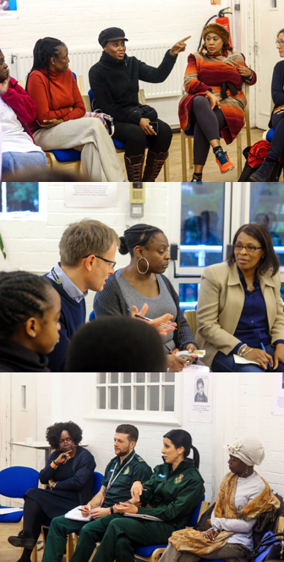
Sickle Cell & Thalassaemia Disorder

Slide 18
Suggestions Included
Staff education, co-designed and co-delivered to address the issues of pain relief and the link with perceived and actual racism of care givers | Co-produce information on the roles and requirements of different LAS staff to share with patients.
Information about key words to use in a crisis | Ensuring gas and air is always available
Patient information and support to develop and follow patient held care/crisis plans | Follow the patient’s need and always carry a person with sickle cell to the ambulance unless they wish to walk.
Use of an App to support people with sickle cell disorder to share information including with consultants | A focus on the handover of pain relief at A&E and the engagement of patients in the handover process.
Support sickle cell patients in a crisis to make informed decisions about when to call an ambulance | Sharing the clinical guidelines for sickle cell with patient groups so that everyone is informed of protocol.
Always say, ‘I can see you’re in pain, how can I help you?’ | Ask: ‘Do you want pain relief? What works for you?’ ‘Shall we get the chair?’

Slide 19
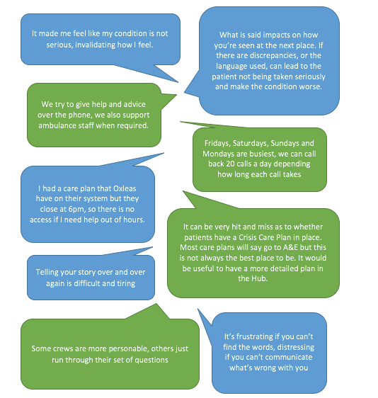
Personality Disorder

Slide 20
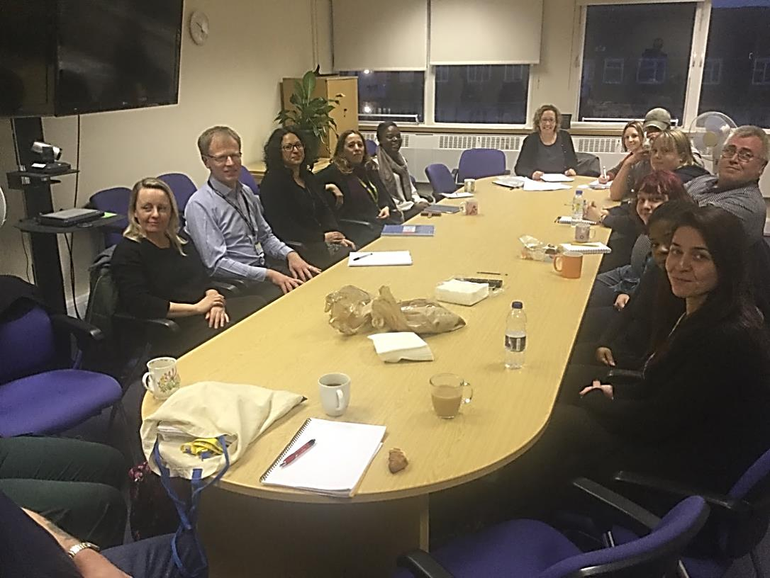
Suggestions Included
Developing principles and statements that could be used to inform the delivery of care to people with personality disorders | More consistent roll out and development of patient held crisis care plans that include things that should/shouldn’t be said and the patients’ preferences rather than treatment
Co-designing training material | Review the personal crisis plan after each crisis with the patient

Slide 21
Conclusions
Ideas generated by the groups were similar:
The value of on-going collaboration and discussion
Learning, education and training
Empowering patients and carers to make the best decisions in a crisis
Better understanding by LAS staff of the unique aspects of certain conditions
Co-produced patient information
Better use of technology
Patient and carer led initiatives
Valuing people as more than their condition
Valuing the role of carers
Better use of resources
Sometimes it’s the simple things that matter most

Slide 22
Next steps
This has been a powerful approach to patient engagement, which will be extended to other groups.
A development plan has been created and many actions have been undertaken since the report was produced.
The Trust will continue to actively listen and engage with people, to hear their experiences, their ideas and their challenges.
These will be used to improve the services we deliver.

Slide 23
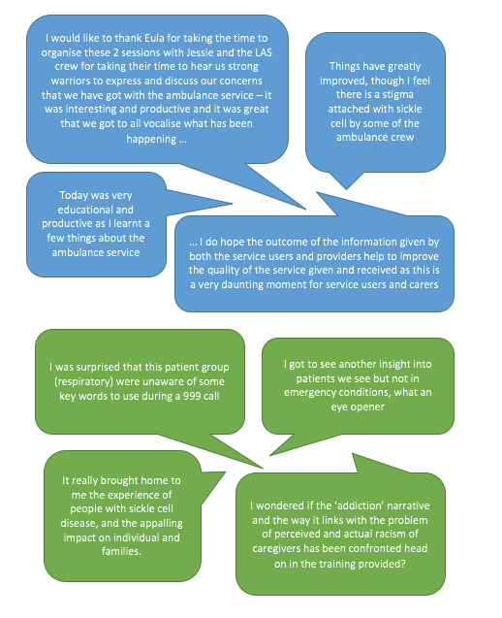

Thanks to everyone for making us so welcome and for participating so generously.
Together we can make a difference.
Jessie Cunnett
Patient and Public Involvement Solutions
March 2017

