Slide 1
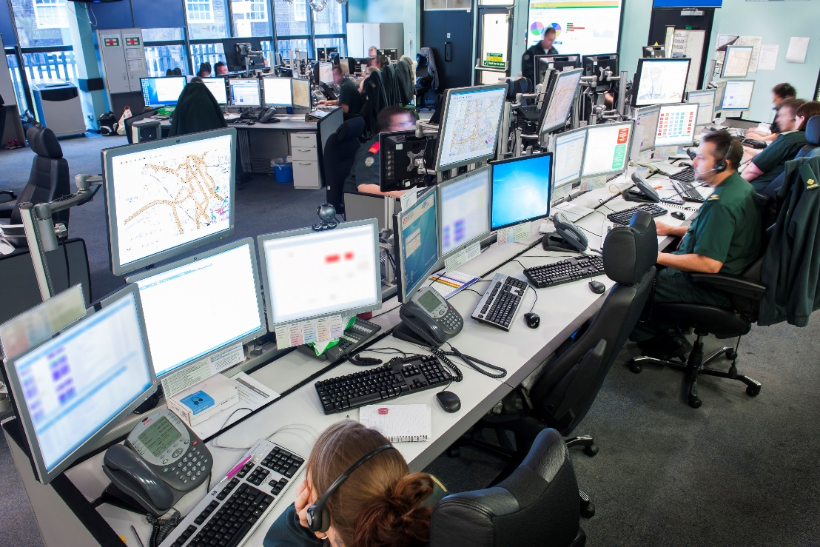
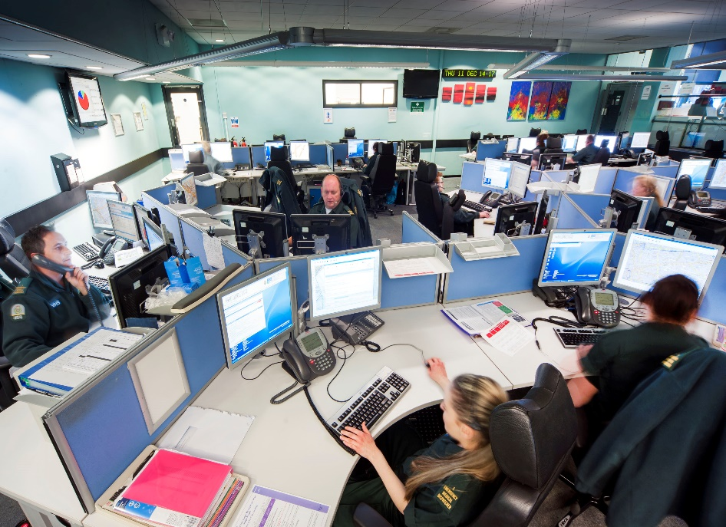
Emergency Operations Centre

Slide 2
Control Services
Introduction
The control room and progress over the last 18months
Roles, responsibilities and specialist desks
Recruitment and retention, ‘where we were and where we are now’
IC and ambulance flow
Managing the peaks in demand
Next steps developing the control room

Slide 3
Introductions…
Deputy Director of Operations for the London Ambulance Service.
Joined the LAS in 1994
In post since 12th December 2016
Previously the Assistant Director for Operations in NWL.

Slide 4
Progress over the last 18months
CAD fail on New Years Day
4 major incidents
Demand exceeding capacity
Interim operational management structure (Sept 2017)
Introducing leadership for CAD, call handling and performance
Introduced ARP in November 2017
Increased focused on staff welfare
Signals from Noise performance monitoring tool
Recruited 126 new staff to the control room
Reduced the rate of leavers/movers to 83 last year
Enhanced recognition of excellence, wall of life
Increased communications, email, visibility days and VLogs
Notes:
EMDs the front line for the patient
Greater focus on learning and reviewing after incidents
Visibility of leadership in the control room
Previous leavers were over 100

Slide 5
SfN – Cat 1 early predict

Slide 6
SfN – cardiac arrest performance

Slide 7
Roles & Responsibilities- Senior Management
Deputy Director of Operations
Head of Emergency Bed Service
Head of Clinical Hub
General Manager
x 6
Head of Quality Assurance
Practice Learning Manager
Responsible for onward sharing of safeguarding referrals of patients (adults & children) made by LAS staff
Responsible for the Clinical HUB
Responsible for:
Waterloo
Bow
Call handling
Performance
Technology & Resilience
Innovation
Responsible for quality, governance and learning from incidents
Responsible for education of new EMDs in the training environment and ongoing learning of staff.

Slide 8
Roles & Responsibilities- Watch Management
Watch Managers
Bow
Watch Managers Waterloo
MET
DG
Joint
Response
Unit
Incident
Management
Desk
Intelligent
Conveyance
Blue
Calls
CAD ling to MPS for sharing of critical information
FRUs working in conjunction with the MPS on calls where join skills are requested.
Responsible for overseeing response to ‘smaller’ incidents requiring multiple resource response
Aims to help reduce the surge impact of ambulance arrivals
Responsible for passing information of critical patients to the receiving hospital

Slide 9
Recruitment and retention, ‘where we were and where we are now’
Review of resource levels in mid 2017
73 additional posts identified as required (and funded)
Leavers v joiners
Current vacancies
Reasons for leaving
Cost of living / banding
Demand / pressures
Career pathway
New expectations
Notes:
126 joiners v 43 leavers
Some within our girft some outside
Raised the issue of EMD remuneration nationally - not just us

Slide 10
IC and ambulance flow
Aims to help reduce the surge impact of ambulance arrivals
Threshold triggers set for each ED depending on size based on a rolling 60 minutes
Reviewed by NHSE in 2016
IC does support the system during pressurised periods
It has limitations due to the volume of conveyances (59%) which are exclusions.
Full visibility of EEAST IC functions
Notes:
Began November 2013
Winners and losers
Exclusions – Blues calls, Critical pathways, complex needs, paeds, HCPs
Activity shared monthly with Acutes

Slide 11
What is an average day…….
4,400 calls into the control room in January (avg by day)
Busiest day this year 5th March (5973 calls)
Lowest volume 2nd April (3,663)
Multi skilled staff
Incident delivery desk
Special Operations Centre
Senior leadership on call

Slide 12
Next steps developing the control room
Complete and continue the recruitment
Develop a clear Emergency Medical Dispatcher career pathway
Integrate the Clinical Hub with the iCAT.
Develop the recognition of EMDs in the Customer Services qualifications.
Introduce a co-ordination centre for London

