Slide 1
Diabetes Programme
Alice Ridley – LAS Paramedic and HIN Darzi Fellow
Laura Spratling – Senior Programme Manager, Diabetes Theme, HIN
Notes:
NHP

Slide 2
Health Innovation Network
Health Innovation Network is one of 15 Academic Health Science Networks (AHSNs) set up across England in 2013
AHSNs have four key objectives nationally:
Focus on the needs of patients and local populations
Speed up the adoption of innovation into practice to improve clinical outcomes and patient experience
Build a culture of partnership and collaboration
Create wealth through co-development, testing, evaluation, early adoption and spread of new products and services
Membership organisation focused on spread and adoption of system-wide lasting improvements in patient and population health
Capitalise on relationships, and teaching and research strengths across South London

Slide 3
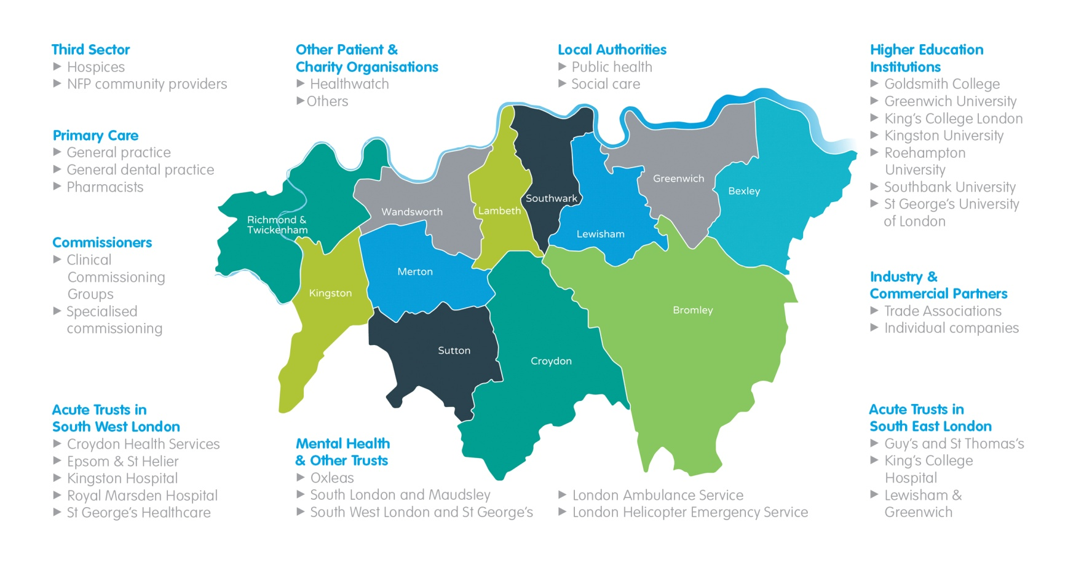
Health Innovation Network
Our diverse membership includes all health and care providers (community, acute, mental health and primary care), commissioners, local authorities and higher education providers.
All our work programmes have strong relationships and collaboration with patient and industry partners.

Slide 4
Priorities
We have prioritised health challenges for our local communities…
CLINICAL THEMES
CROSS-CUTTING THEMES
Patient & Public Involvement
Diabetes
Wealth Creation
Dementia
Patient Safety
Musculoskeletal
Informatics
Alcohol
Patient Experience
Cancer
Education & Training
…creating clinical and cross-cutting themes, with patient and public involvement running throughout all of our programmes.

Slide 5
Diabetes high level themes
Supporting better self management
Adopting new technologies
Enabling systems for integration of care
Joint Strategic Needs Assessments were used to identifying key areas of variation and risks.
High level priorities were developed and refined by the programme team in consultation with a wide range of stakeholders.

Slide 6
Current projects:
Improving self-management of insulin therapy by improving access to and appropriate use of technologies
Improving the integration of care pathways for management of unscheduled care in hypoglycaemia and hyperglycaemia
Right Insulin, Right Time, Right Dose
Structured education and related support for self-management

Slide 7
Improving the integration of care pathways for management of unscheduled care in hypoglycaemia and hyperglycaemia

Slide 8
Integration of care for people who experience serious hypo or hyperglycaemic events
Working with the Clinical Audit and Research Unit (CARU) at London Ambulance Service (LAS)
LAS attends approximately 20,000 diabetic emergencies per year (www.londonambulance.nhs.uk):
- hypoglycaemia (low blood sugar) – 11,000 (50% seen and treated in the community)
- hyperglycaemia (high blood sugar) – 9000 mostly diagnosed diabetic patients
October 2012: LAS launched new pathway in which GPs are informed of the event within 24-48 hours (with patient consent)
Project objectives:
Work with LAS to evaluate implementation of current pathway
Is the information being shared by LAS resulting in the best possible care for patients?
Work with service users and providers to develop and implement new pathways that improve patient outcomes

Slide 9
London Ambulance Service enhanced pre-hospital practice guidelines 2012-2013
Diabetes patients who experience a hypoglycaemic episode requiring ambulance assistants can follow one of 2 pathways….
Diabetes patients requiring insulin – The LAS pathway recommends a 2 step approach
Any non-conveyed patient should receive a call-back within 2 hours to check their recovery status
Any non-conveyed patient should be referred back to their GP allowing further self management advice and adjustment of medication regimes by the patients GP/diabetic nurse
Diabetes patients requiring tablets only – LAS pathway recommends that all diabetic patients who are on tablets only should be conveyed to their local A&E for further investigations and management

Slide 10
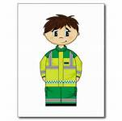
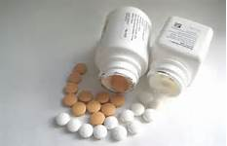
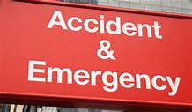
HYPO
C.S.D.
E.B.S.
Consent
E.B.S.
2 hour call back
Clinician calls patient back and asks:
‘How are you?’
‘Have you eaten?’
‘What is your blood glucose reading?’

Slide 11
The project so far…
Diabetic emergency calls to LAS (South London) collected from September – December 2013
Data from 4 boroughs analysed (Croydon, Lewisham, Sutton and Merton)
Recurrent callers for each borough mapped
Workshop for all South London boroughs arranged for 11th February 2015 – Guest Speaker, Professor Stephanie Amiel, RD Lawrence, Professor of Diabetic Medicine, King’s College London

Slide 12
Lewisham – showing indicative referral rates
September-December 2013
172 diabetic emergencies
75 hypers
* non-conveyed
74 conveyed
94 hypos
Pathway eligible (insulin)
70 patients
6 non-conveyed
51 non-conveyed
19 conveyed
Pathway non-eligible (oral medications)
24 patients
18 conveyed
23 not referred to GP (45% non-referral rate)
19 GP referrals
* diabetic emergencies
9 declined GP referral

Slide 13
Recurrent callers
81-90 years
Female
Day 1
Non-conveyed hypo
GP referral
Insulin
Day 2
Non-conveyed hypo
GP referral
Insulin
Day 2
Conveyed hypo
Insulin
Day 17
Non-conveyed hypo
GP referral
Insulin
Day 30
Non-conveyed hypo
No GP referral
Insulin
Day 40
Conveyed hypo
Insulin
Day 1
Non-conveyed hypo
No GP referral
Insulin
Day 51
Non-conveyed hypo
No GP referral
Insulin
31-40 years
Male

Slide 14
Day 1
Non-conveyed hypo
No GP referral
Insulin
Day 17
Non-conveyed hypo
Refused GP referral
Insulin
Day 24
Non-conveyed hypo
Refused GP referral
Insulin
Day 43
Non-conveyed hypo
No GP referral
Insulin
Day 51
Non-conveyed hypo
No GP referral
Insulin
Day 51
Non-conveyed hypo
Refused GP referral
Insulin
Day 57
Non-conveyed hypo
No GP referral
Insulin
Day 63
Non-conveyed hypo
No GP referral
Insulin
Day 65
Non-conveyed hypo
GP referral
Insulin
31-40 years
Female
31-40 years
Male
Day 1
Non-conveyed hypo
Refused GP referral
Insulin
Day 8
Non-conveyed hypo
No GP referral
Insulin
Day 12
Non-conveyed hypo
GP referral
Insulin
Day 15
Non-conveyed hypo
Refused GP referral
Insulin
Day 17
Non-conveyed hypo
No GP referral
Insulin
Day 47
Non-conveyed hypo
No GP referral
Insulin
Day 49
Non-conveyed hypo
GP referral
Insulin
Day 52
Non-conveyed hypo
GP referral
Insulin
Day 53
Non-conveyed hypo
GP referral
Insulin
Day 54
Non-conveyed hypo
Refused GP Referral
Insulin
Day 55
Non-conveyed hypo
No GP referral
Insulin
Day 56
Non-conveyed hypo
No GP referral
Insulin
Day 66
Non-conveyed hypo
No GP referral
Insulin
Day 80
Non-conveyed hypo
GP referral
Insulin

Slide 15
Objectives
Review National Ambulance guidelines on the clinical treatment of hypoglycaemia
Enhance the referral pathway/process and work with the LAS to increase referral rates to 100%
Work with South London boroughs to develop the best pathway that links LAS with other parts of the health system

Slide 16
Collaborative Workshop
A workshop on February 11th for all South London CCGs
This will be an opportunity for all South London boroughs to work together to develop an improved pathway for patients that have suffered a hypoglycaemic episode
Keen for patient and carer involvement
If you are interested in attending please email:
alice.ridley2@nhs.net

Slide 17
Questions
Do you have any experiences of diabetes care that you wish to share?
One of the main aims of this project is to improve communication between LAS and other healthcare professionals. Do you have any experiences of this that you wish to share?
Do you have any ideas for where the HIN could work with LAS to improve care in another area?
Any other questions?

Slide 18
Thank you
alice.ridley2@nhs.net
lauraspratling@nhs.net

