Slide 1
LAS and the Inverse Care Law
Exploring health inequality in London using ambulance data
LAS Patients’ Forum, April 2019

Slide 2

The Inverse Care ‘Law’
Julian Tudor Hart (1927-2018), famous GP in Wales
"The availability of good medical care tends to vary inversely with the need for it in the population served.
This ... operates more completely where medical care is most exposed to market forces, and less so where such exposure is reduced."
Notes:
https://en.wikipedia.org/wiki/Inverse_care_law

Slide 3
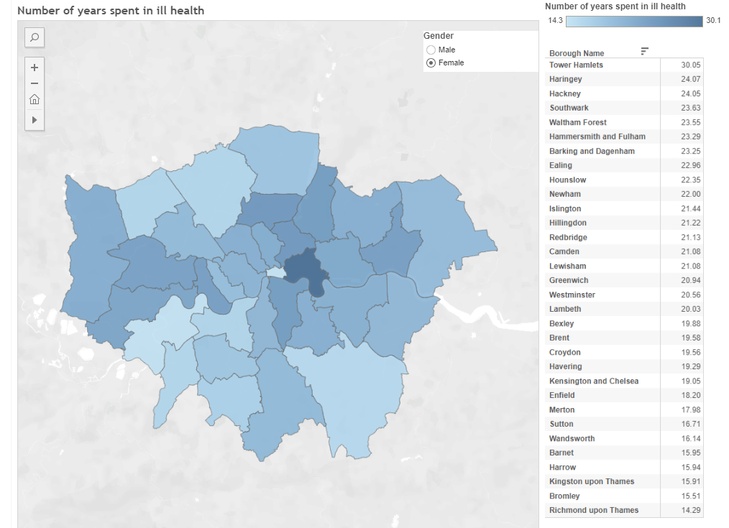
Health inequality in London
Austerity
Inequality
Mayor’s responsibility
  Health services: not devolved
  Responsibility for action against inequality: statutory duty
Notes:
https://public.tableau.com/profile/glaintelligence#!/vizhome/LondonHealthInequalities_0/Dashboard1

Slide 4

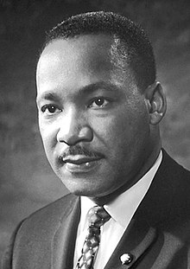
Why think about this?
Chief Medical Officer
“Health is our main asset as a nation – a healthier population translates to a healthier economy. By repositioning health and reshaping our environment, we can make it easier to live well for longer and reduce the gap in health inequalities between the richest and poorest in our society.”
MLK (more or less):
“Of all the forms of inequality, injustice in health care is the most shocking and inhumane.”
Notes:
https://www.gov.uk/government/news/chief-medical-officer-calls-for-unified-approach-to-revolutionise-health-by-2040
https://www.huffpost.com/entry/martin-luther-king-health-care_b_2506393

Slide 5

Yes but… why for LAS?
LAS is the only part of frontline NHS with an overview, serving the whole of London
Dr. Sahota, Dec 2018 Report on Supporting LAS
“As London experiences increasing inequality, overstretched public services, and an ever-burgeoning population, these pressures are also passed onto the LAS in its day-to-day work. This can be seen, most starkly, with ambulances queuing out of A&E departments due to rising demand, insufficient investment and overwhelmed social care services grinding to a halt.”
11 Feb PF meeting: LAS is a ‘canary in the mine’ of London health inequality
Notes:
https://www.london.gov.uk/sites/default/files/london_ambulance_report_final.pdf

Slide 6
Malcolm’s question
Does LAS performance data indicate they might be suffering from the effects of the inverse care law?
To take a look:
  Data about inequality, IMD 2015
  LAS performance data, YTD 2018-9 (by CCG and sector)
  Do they seem to be related?
  Or what else is going on here?
Just a quick look!

Slide 7
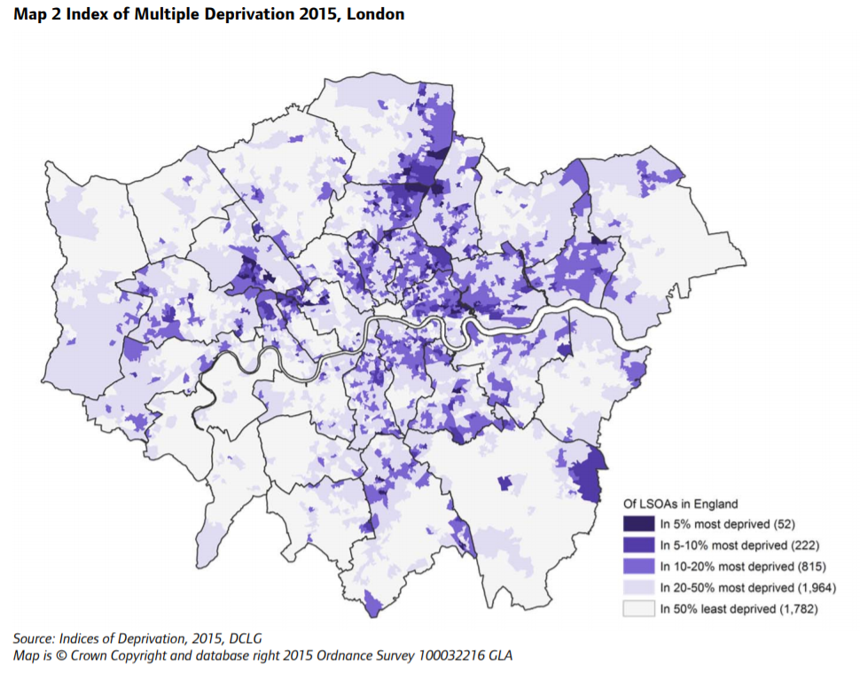
Deprivation: IMD by LSOA, 2015
Notes:
https://files.datapress.com/london/dataset/indices-of-deprivation-2015/2016-05-24T18:16:14/indices-deprivation-2015.pdf

Slide 8
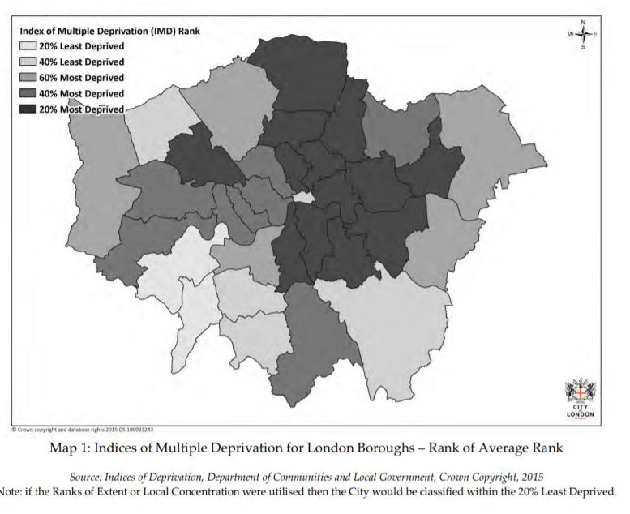
By borough
Notes:
https://www.cityoflondon.gov.uk/services/environment-and-planning/planning/development-and-population-information/Documents/deprivation-index-2015.pdf

Slide 9
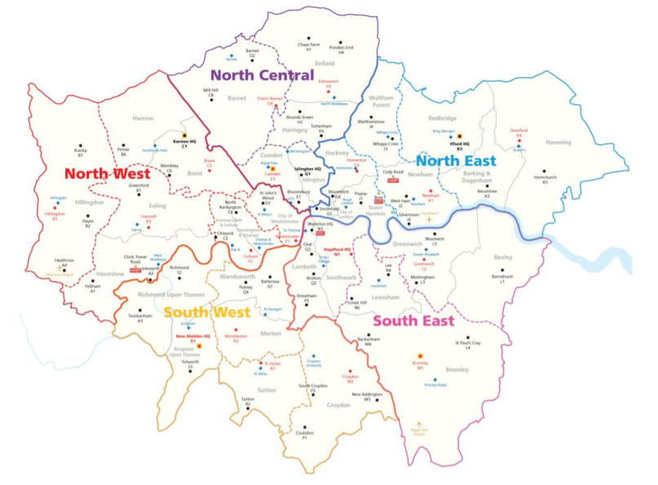
By LAS sector?
Notes:
https://www.londonambulance.nhs.uk/wp-content/uploads/2018/02/Our-strategic-intent-2.1.pdf

Slide 10
A very rough approximation…
Sector | Average of IMD 15 score
N. East | 27. 6
N. Central | 26. 7
S. East | 24.0
N. West | 22.6
S. West | 15.4

Slide 11
Pre-ARP trends on Cat A 8 min, by sector: a North Central problem from about 2015?

Slide 12
Was this down to deprivation?
No correlation at borough/CCG level, but
Suggestion that something going on at sector level

Slide 13
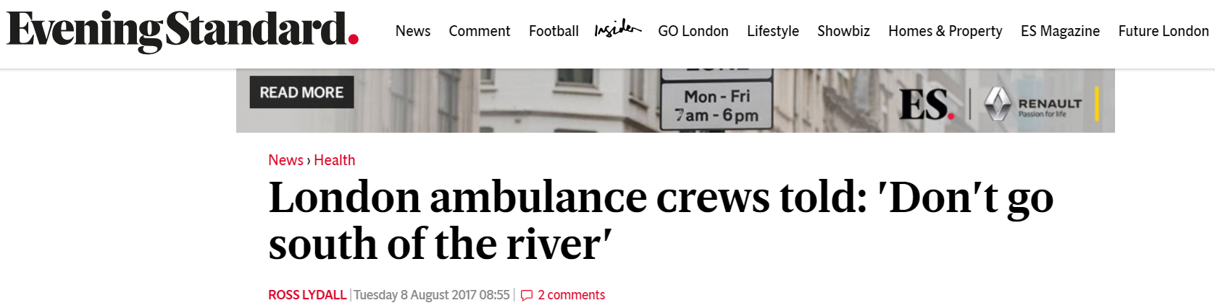
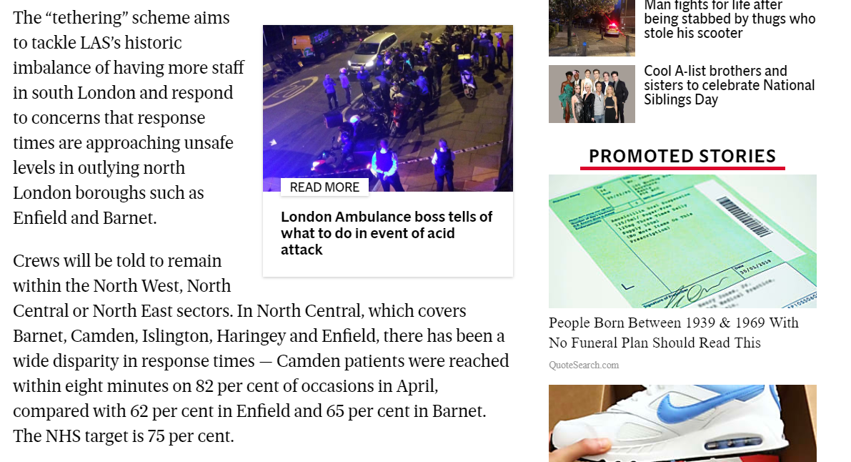
2017 ‘Tethering’ trial
Still going?
Notes:
https://www.standard.co.uk/news/health/london-ambulance-drivers-told-dont-go-south-of-the-river-a3606311.html

Slide 14
Latest performance data, post-ARP

Slide 15
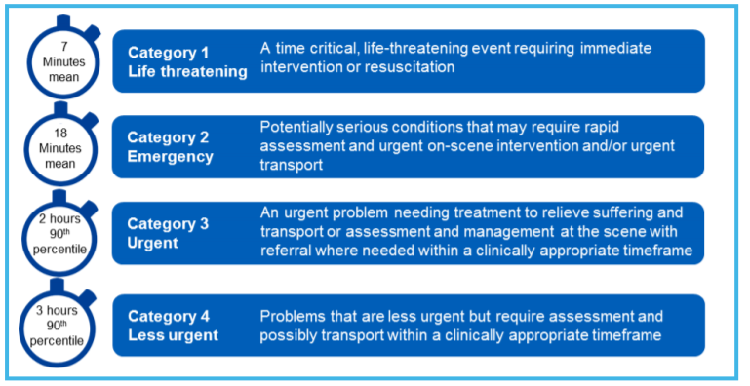
The new categories: a refresher on post-ARP standards
Notes:
https://improvement.nhs.uk/documents/3271/Operational_productivity_and_performance_NHS_Ambulance_Trusts_final.pdf

Slide 16
Sector variation now appears to be non-emergency (C3 and below)

Slide 17
Same at CCG level… (C4 outlier is Enfield)

Slide 18
Is deprivation a driver here?
Maybe… but not directly
  No correlation apparent at CCG/borough
  Sectoral relationship also now gone (see right)
Still seems odd to see such variation in non-emergency categories

Slide 19

LAS: stuck in the middle of a very complicated problem
Demand side
Fewer options for other services?
LAS
Responsibility for balancing supply and demand?
Explaining how resources allocated?
Supply side
Inverse care in wider system?
Complicated politics?
People calling more for non-emergencies?

Slide 20
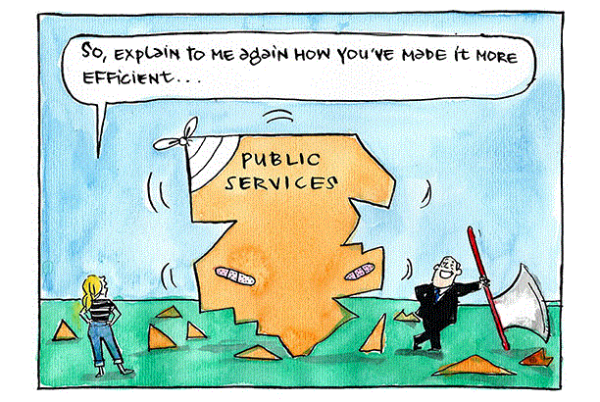
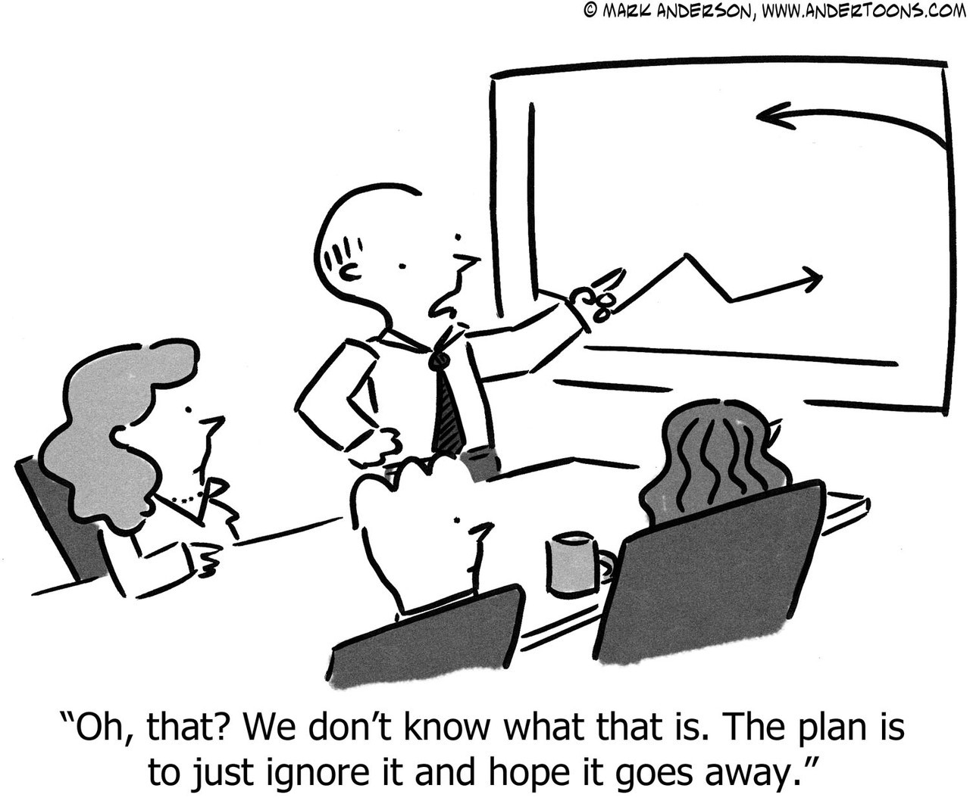
Not talking about difficult issues…
Notes:
https://localgovernmentutopia.com/2015/11/02/189-essay-no-2-local-government-effectiveness-and-efficiency/
https://andertoons.com/graph/cartoon/6751/dont-know-what-that-is-just-ignore-it-and-hope-it-goes-away

Slide 21
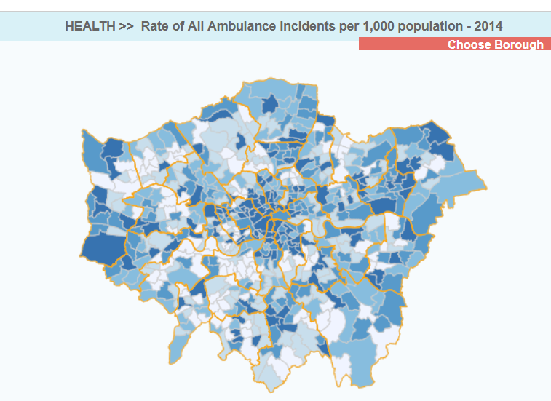
Suggestion: talk about patients more
Data on demand, not just performance
Explain variations in performance and what is being done
Put public pressure on leaders, not NHS
Notes:
http://londondatastore-upload.s3.amazonaws.com/instant-atlas/ward-profiles-html/atlas.html

