Slide 1
London Ambulance Service
- Improving Mental Health
Patient and Public Involvement
2015

Slide 2
Introduction
London Ambulance Service wants to improve its provision to people with mental health needs
We spoke to 63 patients, carers and staff in 7 focus groups to get their views
Notes:
Focus groups were carried out between March and September 2015.
6 with patients and one with staff.

Slide 3
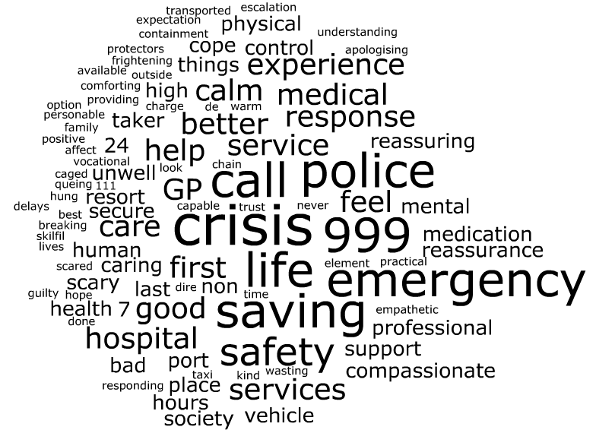
The London Ambulance Service: a patient view
Notes:
We wanted to find out what the London Ambulance Service means to patients.
Responses to this question were more positive than negative.
Some comments related to a general perception of the service such as: ‘an immediate response’, ‘life-saving’, ‘first port of call’, ‘safety net’, ‘being taken to a place of safety’, ‘professional calmness’, ‘calling an ambulance is the last resort’, others spoke of their fears
Other comments related more directly to people’s personal experiences. Many people spoke about the ambulance service as part of a network of support for them alongside GPs and their MH professionals, The ambulance service was seen as out of hours support in the absence of other services in the evenings and at weekends.

Slide 4
What’s important when I contact you?
Understanding about capacity
Listen to my fears
Calm and reassuring response
De-escalate the situation
Knowing there is a process you follow to help me
Don’t treat me differently
Notes:
We asked what patients wanted when they contact the ambulance service in an emergency.
There was a feeling that a greater expertise was needed amongst staff about mental health and its impact. People saw a direct link between a lack of community based services and their likelihood of having a crisis and needing to call an ambulance. Some people were keen to avoid this situation and felt that an admission to hospital was not a good outcome, they wanted an alternative solution such as a crisis card or specific MH protocol which includes organisations someone can call and things to say and do which are supportive.

Slide 5
Delays – how should this be managed?
Honesty – what is really going on?
Keep talking to us…
Equality of service
Be able to deal with an escalating crisis
Understanding we have no-one else to call
Community responders / street triage
Notes:
Overall, continued communication was key… patients and carers spoke of the need to have clear information and communication about delays – text and email alerts were suggested. Some people told us they waited for hours or didn’t get an ambulance at all.
Staying on the line and talking things through was very important with regular call-backs or the suggestion of family/friend buddy if that was not possible.
MH patients spoke of feeling that they needed to escalate their own crisis to get a response – again the need for staff to be able to de-escalate and manage those situations was very strongly put across
People wanted to be treated fairly, regardless of whether they were known or not. There was a feeling among some of the groups that known patients received different treatment, or that people with MH issues were treated differently.
Across the groups, people spoke of a lack of community support out of hours and how they feel that they have no-one else to turn to in a crisis but the ambulance service
Discussions across several groups about Community responders / street triage were described as better for the patient and the ambulance service as they can assess before the ambulance arrives.

Slide 6
What would make me say thank you?
Treating me like a human being, not a fruit and nut case
If the call handler asked for my crisis plan
Being treated with dignity and respect
Treating carers as experts
If you were comfortable and relaxed about my mental health
Keep doing what you do
Notes:
We asked patients what would make them thank the ambulance service. Many were positive about the service they receive and the professionalism of the staff. They also said that they would not know how to say thank you to an ambulance team as they would have no idea how to contact them.

Slide 7
What advice would I give?
Take me seriously
Don’t use fancy words
Don’t be afraid of me
Remember… we all forget things
Don’t make assumptions
Stay with me, don’t leave me alone
Have Mental Health nurses to respond to calls
Listen to us and learn more
Notes:
People in each group valued being asked this question and were very willing to provide constructive advice.
Answers were themed in 3 main areas: first click – general attitude and communication - communication came through as a strong theme and the need to be non-judgemental and not be afraid.
Click 2 – specific MH answers - As with previous questions, there was repetition of the fact that people did not want to be left alone and
Practical suggestions – click 3 - suggestions were made about community responders / street triage / MH nurses on the phone as solutions to this.

Slide 8
Staff views
Why do people ring 999?
They know they are guaranteed a response
Lack of specialist MH services to get advice from / refer in to in an emergency
Problems with this
By the time the patient has seen the emergency department, the crisis is normally over
MH patients need time on the phone – have specialist call handlers available who are able to do that
Notes:
There were similar responses from the staff about why they thought patients ring 999 as the patients themselves had focus about challenges in dealing with MH patients when there are time pressures and a lack of expertise in the CHUB. Most felt that learning from others and the expansion of a specialist team of call handlers would be a definite benefit

Slide 9
Staff views
What else can we do?
Learning from the Police on their ABC 136 assessments
Develop Patient specific protocols
Simplify our Safeguarding processes
Better and more training on Mental health and related issues (capacity, welfare, safeguarding…)
GOLD STANDARD - patient calls 999, gets a mental health nurse and specialist vehicle and are taken to a suite, 4 days later they are followed up on, the crews are
updated and a plan is then put in place.
Notes:
There was frustration on behalf of patients, service users and carers at how ther service was provided and there was a clear idea on what could be done to provide a GOLD STANDARD service.

Slide 10
What would work for you?
Pan London approach
MH nurses in the hub
Simple safeguarding process
Alternative to hospital – street triage
Having a full picture of patient needs
Specialist MH training
Notes:
When asked what LAS could do to improve the service for MH patients, a strong theme was a pan London approach. This was seen as crucial with clear pathways so that all London patients could be supported by the same level of expertise.

Slide 11
Conclusions and next steps
Initial contact and response
Where possible call handlers should give an accurate description of what time help will arrive. Introducing the use of regular text or call updates to let people know when help will arrive would provide reassurance
All call handlers should receive training in basic mental health as part of their induction and orientation
Education and training
To enhance existing training in mental health it would be beneficial if all patient facing staff could receive yearly face to face updates or ongoing mental health training in addition to their core mental health training.
Additional personal development would help to build an internal cohort of champions with knowledge and skills to be shared
Notes:
The evidence gathered from participating patients, service users, carers and staff has been summarised and 15 Recommendations for action have been made based on the key themes which came out of the work. These are detailed in sections 15 to 18.

Slide 12
Conclusions and next steps
Crisis prevention
Collaborative work with CCGs and other partners to ensure the impact of crisis on the whole pathway is being considered
Receiving the right kind of help
A collaborative scoping study into developing an intervention such as a community responder service with a mental health specialism
Mental health nurse role to be extended further to provide dedicated mental health nurses that could attend with Ambulance
Explore use of Patient Specific Protocols in some cases
Work with partners to explore consistent use of crisis cards
Notes:
More needs to be done to build relationships with partners working in mental health across London to achieve these. This section of recommendations is themed around working more closely with national and local partners to create a web of information and tools which can be accessed by LAS staff and used to improve the experience of patient s and service users with MH issues.

Slide 13
Conclusions and next steps
Being referred to or transported to the right place
A range of options in addition to A&E and mental health hospitals would be ideal such as a crisis suite
Further roll out of the existing Street Triage schemes to create a London wide service
Providing Feedback
Ensure this report is sent to all those who participated
Undertake a campaign to explain how people can provide feedback and where it can be sent to
Establish a Mental Health Improvement Group, with involvement from patients, service users and staff who have been involved so far to support the implementation of actions agreed as a result of this report
Notes:
Continuing the theme of working with partners

Slide 14
Questions??
info@patientpublicinvolvement.com
www.patientpublicinvolvement.com
07964 007884
@ppisolutions

