Slide 1
London Ambulance Service
March 2018
Hospital Breaches

Slide 2
Hospital Handover Summary
Hospital Conveyance Lost Hours March 2018

Slide 3
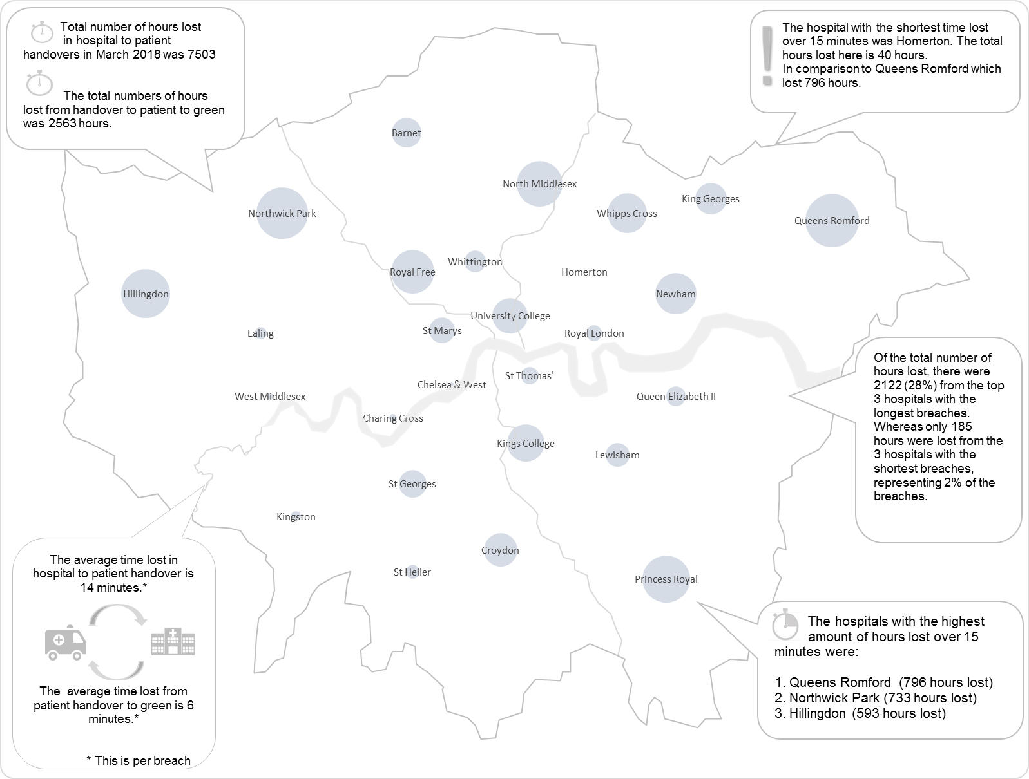
Hospital Handover Summary
Hospital Conveyance by Location March 2018
This map shows the location of each ED hospital across London.
The size of the bubble relates to the comparative hours lost* at that hospital.
The larger the bubble, the more hours lost at hospital.
For example, during the reporting week, the highest hours lost were at Queens Romford.
The fewest hours were lost at Homerton, as the bubble can barely be seen
* Total time accrued after 15 minutes, for arrival at hospital to patient handover.
 | Highest number of hours lost.
 | Lowest number of hours lost.

