Slide 1
Joint strategic aims for the ambulance service in London
LAS Patient Forum – 10th October 2016

Slide 2
Introduction
This presentation provides an overview of:
The five London Urgent and Emergency Care (UEC) Networks’ priorities for the ambulance service as outlined in Sustainability and Transformation plans (STPs)
Outputs from workshops hosted by the London Ambulance Service (LAS) commissioner to discuss demand management and commissioning strategy priorities
The priorities identified in both the STPs and the workshops align. As such, and with the LAS currently revisiting their strategy, they present an opportunity for the development of a joint London-wide strategy on behalf of UEC networks and LAS commissioners. Like STPs, this could be a five-year view of transformation that also includes more immediate actions. The LAS Strategic Commissioning Board (SCB) which has representation from SW, SE, NE NW and NC London CCGs could be the Forum for further development and endorsement of the strategy.

Slide 3
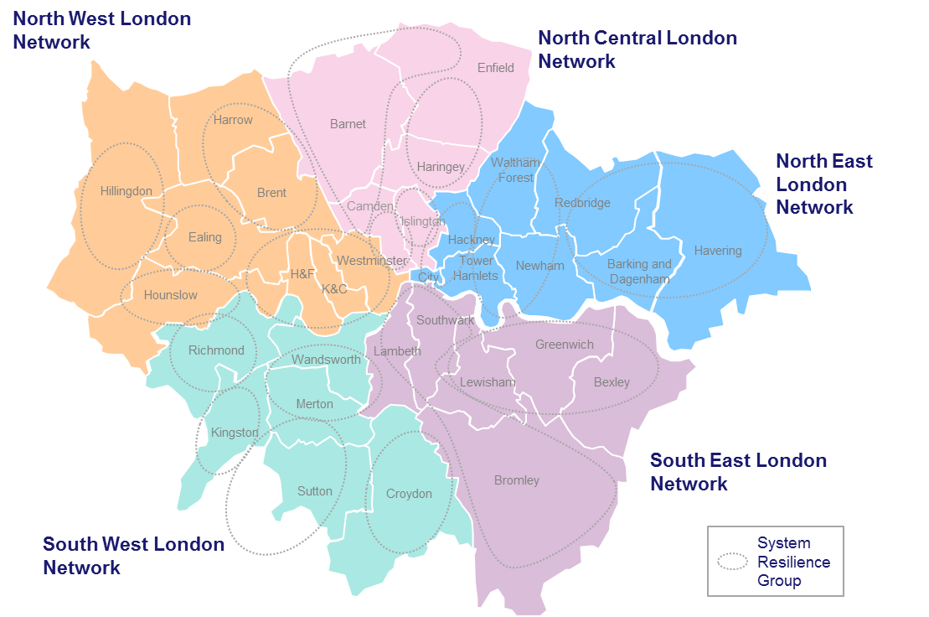
Context
Five U&EC Networks, aligned with STP footprints, have been established across London with the following general objectives:
Operating strategically to improve the consistency and quality of UEC by bringing together constituent System Resilience Groups (SRGs) and other stakeholders
Maintaining oversight of, and ensuring accountability for outcomes across the whole UEC system.
Defining consistent pathways of care and equitable access to services for both physical and mental health;
Coordinating workforce and training needs
Ensuring the building of trust and collaboration throughout the network
Spreading best practice

Slide 4
Summary
To ensure that patients are receiving high quality care in the appropriate setting, reductions in LAS demand and ED conveyances are presented as the key joint strategic aims.
Informed by the five London STPs/ UEC Networks, LAS demand management and commissioning strategy workshops, LAS Clinical strategy and National Ambulance Programme, key priority areas are outlined to achieve these aims:
Ongoing and required programmes of work for each are presented.
Triage & response times
Efficient job cycle time
Reduce A&E Handover times
Access between IUC and LAS (clinical hub and crews)
Alternatives for Care Homes
Alternatives for Frequent callers
Consistent ACPs for agreed conditions
Consistent direct access to co-located UCCs
Consistent Mental health crisis care
Enhanced digital capability
Appropriate workforce

Slide 5
Joint strategic aims for the ambulance service
Strategic priorities for the ambulance service are being considered across a number of forums:
Five Sustainability and Transformation Plans (informed by UEC Networks)
LAS clinical strategy
National Ambulance programme
In light of this, joint strategic aims for the ambulance service in London are being developed:
To capture the UEC system’s ask of LAS and LAS’s ask of the wider UEC system
To ensure consistency across London
These will be the joint view of the five London STPs/ Urgent and Emergency Care Networks and the London Ambulance Service.
Ongoing strategic planning:
To inform:
UEC element of STPs
UEC element of STPs
LAS Clinical strategy
LAS Clinical strategy
Ongoing joint monitoring of delivery
Joint strategic aims and Delivery plan
National ambulance programme
LAS commissioning intentions
Best practice analysis
Demand and activity analysis

Slide 6
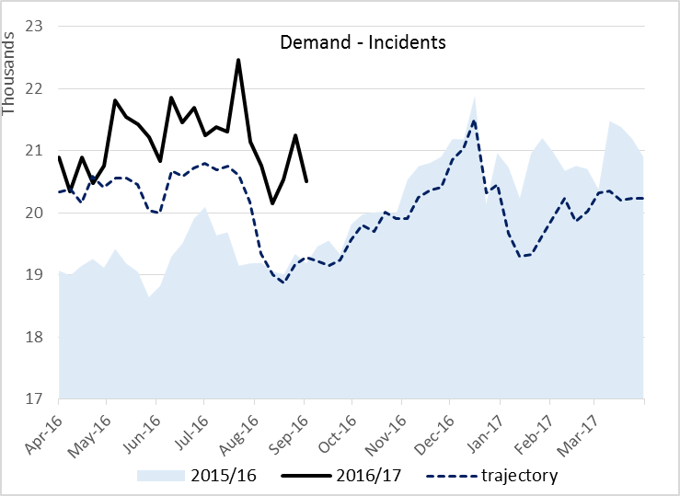
LAS and ED challenges
LAS Demand
Demand for LAS is growing faster than population growth.
Illness type has remained consistent over recent years, however, the demand from the elderly is growing as a proportion of total activity.
In 2017/18, the total growth above 2016/17 contract is estimated at 12.3% (131k incidents). Options to address this (note these are to highlight the impact):
Demand. Avoid 131k incidents (or more).
Capacity. This would require an additional 243 WTE plus capacity – vehicles, kit, estate, training etc (circa £20-25m).
Productivity. Take 18-23 minutes off Job Cycle Time
ED Demand
Demand at Emergency departments in London has continued to rise.
Whilst the percent of LAS conveyances has remained steady, the absolute numbers have risen.
Improving the capacity and productivity of the acute system is one way to address this increase in demand, as is reducing the number of ED conveyances by LAS
LAS Incidents 2015/16 = 1,047,367
6

Slide 7
UEC system joint strategic priorities
The challenge - pan-London actions are required to:
Reduce LAS demand and improve capacity and productivity
Reduce ED conveyances
The solution:
Simply building capacity is not the right solution.
A mix of addressing demand, capacity and productivity.
Identify and deliver through STPs; LAS and National priorities
Consistency across London
Focus on those areas likely to have the highest impact
This will ensure:
People with urgent care needs receive a highly responsive service closer to home;
and those that need it are conveyed in a timely fashion to centres with the best expertise and facilities.
Development and delivery of system-wide joint strategic aims
Aligned joint strategic aims for the ambulance service in London:
(Identified from the five London STPs/ UEC Networks, LAS demand management and commissioning strategy workshops, LAS Clinical strategy, National Ambulance Programme)
Triage & response times
Efficient job cycle time
Reduce A&E Handover times
Access between IUC and LAS (clinical hub and crews)
Alternatives for Care Homes
Alternatives for Frequent callers
Consistent ACPs for agreed conditions
Consistent direct access to co-located UCCs
Consistent Mental health crisis care
Enhanced digital capability
Appropriate workforce

Slide 8
Shift in activity assumptions
5% Reduction in LAS demand (by reducing incidents & improving productivity)
Shift in activity assumptions are required to plan for services at a commissioning and provider level:
The LAS Demand management workshop (12th September) asked the UEC system to commit to a minimum 5% reduction in LAS demand by 2016/17
Similarly, a commitment to reducing ED conveyances is required (2015/16 ED conveyance rate = 66%)
These reductions in demand are intended be achieved by the identified priority areas. Demand and activity analysis has been initiated to validate and specify these assumptions to support local planning. Further modelling of impact is required to support this.
Triage & response times
Efficient job cycle time
Reduce A&E Handover times
Access IUC and LAS (clinical hub and crews)
Alternatives for Care Homes
Alternatives for Frequent callers
Consistent ACPs for agreed conditions
Consistent direct access to co-located UCCs
Consistent Mental health crisis care
Priority areas:

Slide 9
UEC system joint strategic aims
Strategic aim | What is ongoing?
Triage & response times | National Ambulance Programme: The use of a new pre-triage set of questions to identify those in need of the fastest response at the earliest opportunity (Nature of Call): The LAS NPDS system already meets these requirements therefore no further action required. Dispatch of the most clinically appropriate vehicle to each patient within a timeframe that meets their clinical need (Dispatch on Disposition): As a DoD pilot site, LAS currently allows 180 seconds for dispatch. Implement new evidence-based set of clinical codes that better describe the patient’s problem and response/ resource requirement: LAS is not included in the initial pilot of this scheme.
Efficient job cycle time | LAS programme of work Reviewing rest break policy Staff engagement and communications Technical developments
Reduce A&E Handover times | The LAS have been working closely with NHS England and NHS Improvement to engage hospitals across London to better manage delays to patient handovers. The patient handover system has been reviewed and meetings taken place between a number of A&Es and the LAS “Safe, Faster, Better “ best practice guidance

Slide 10
UEC system joint strategic aims
Strategic aim | What is ongoing?
Access IUC and LAS (clinical hub and crews) | Patient Relationship Manager (PRM) development Green ambulance – Review from a 111 clinical advisor has reduced green ambulance dispositions by 70% Development of mobile Directory of Services
Alternatives for Care Homes | Sutton Homes of Care – Vanguard Programme - Reduction of 5.80% in LAS call outs and conveyances from 2014/15 to 2015/16
Alternatives for Frequent callers | Darzi fellow report and LAS work has formed a London wide vision for frequent callers: Pro-active identification and early interventions for new frequent callers Local frequent caller forums to case manage escalating frequent callers A&E Delivery Boards to review prolific frequent callers

Slide 11
UEC system joint strategic aims
Strategic aim | What is ongoing?
Consistent ACPs for agreed conditions | Examples of best practice identified
Consistent direct access to co-located UCCs | An Urgent Care Centre specification has been developed for London to support development of a consistent service. The specifications states the requirement for UCCs to accept ambulance conveyances. Clear, agreed conveyance protocols need to be developed.
Consistent Mental health crisis care | S136 pathway and HBPOS specification developed. HBPoS options analysis looking at how London sites can meet the specification, new configuration of sites could be proposed.
Digital | Investment case for digital capacity Coordination of capital funding bids
Workforce | LAS workforce development

