Slide 1
ONCE FOR LONDON IMPROVEMENT PROGRAMMES
Urgent and Emergency Care (UEC) Accelerated Improvement Team
Briony Sloper
Senior Improvement Advisor

Slide 2
Urgent and Emergency Care Improvement
Focused improvement along the whole UEC pathway

Slide 3
How does this programme fit within the wider system…?
3

Slide 4
LONDON WIDE PROGRAMMES
Alternative Care Pathways
Utilisation of 111 *lines (LAS/care homes/RR teams)
Community Response Options/mapping/gap analysis/pan London recommendations
Vulnerable patient flags (CMC/Frailty/MH/Falls risk)
Same Day Emergency Care (SDEC)
Standardised pathways
Reduced variation in the ability to access
Direct access for key conditions
Acute frailty services available at the first pint of contact with UEC care closer to home
Enhanced Health in Care Homes (EHCH)
Support care home staff to recognise the deteriorating patient
Provide additional primary care and community services support
Expected death pathways
High Intensity Users
Identify the different models and approaches currently in place across London and understand their impact
4

Slide 5
Alternative Community Pathways

Slide 6
NHS 111 *Lines
Avoiding admissions - Supporting London Ambulance, Care Homes and Community Teams to keep residents in their home with access to clinical advice and alternative care pathways to support admissions avoidance
Designed to enable particular callers to use their telephone key pad to connect quickly with a clinician in the NHS 111 contact centre.
Dial 111 press *5 for LAS crews attending incidents at patient’s homes or care homes.
Dial 111 press *6 for care home staff who require urgent clinical advice and support.
Dial 111 press *7 for Rapid Response community nursing teams and domiciliary care workers.
*Line calls are routed to a NHS 111 service adviser who takes the patient details and transfers the call to a Clinician - if the clinicians are already on a call there is a guaranteed call back within 20 minutes
6

Slide 7
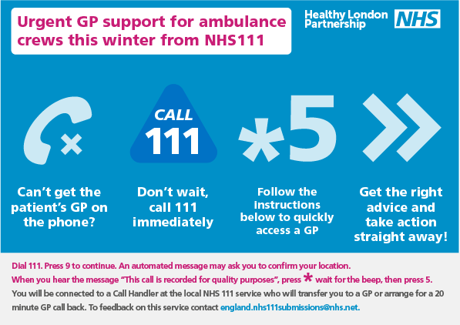
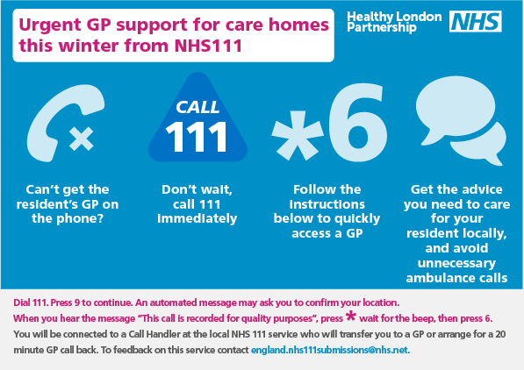
Adding value to by providing fast track access to a GP with * Lines
Managing Demand through 111/IUC CAS
IUC CAS Intro
Direct Booking
Cate 3/4 & ED Validation
London PRM
Star Lines
Dental
Records Access
111 Online
Online ons
Supporting Long term plan commitments for “No decision alone” – Providing London’s health and social care workforce with access to a fast-tracked GP advice through a dedicated line.
95% calls are closed or referred to Primary-Community Care
across London by GP in the CAS following advice to the * line caller vs. overall 111 service which has an average closure rate of 77%
Only 4% of cases require ED or Ambulance Referral
after GP consultation compared with overall 111 service of 10%. A direct impact in reducing emergency dispositions.
39,609
* calls
In 2018
(37% from LAS Crews / 60% from Care Homes)
11.5%
Increase in
* calls from 2017 to 2018
Prevented
Previous year on year increases (7% annually)
of care home calling 999 post *line introduction.
LAS Crew Feedback after using the *5 service:
said the GP was helpful
88%
Impact
on Emergency Services

Slide 8
Evaluation of 111 * Lines
Partnership between Healthy London Partnership (HLP); End of Life Care Clinical Network; London Academic Health Science Networks
Line use was reducing across London and the aim of the project was to understand why this might be
Where a *line number is used 999 ambulance and transport to A&E is reduced significantly
Methodology
Survey of users of 111star*lines – LAS staff, Care home staff, rapid response teams
Analysis of 111star*line data; numbers, outcomes
Review of end to end 111star*line calls
Key Findings

Slide 9
Referring patients directly into community Rapid Response pathways from LAS and 111 IUC Clinical Assessment Service
The Integrated Urgent Care Service Specification (2017) says that “The model for an IUC CAS requires the following offer for patients: …direct booking post clinical assessment into a face-to-face service where necessary”
The NICE Guidance on Intermediate Care including Reablement (2017) recommends that practitioners ensure that crisis response can be started within 2 hours from receipt of a referral. Crisis response are “community-based services provided to people in their own home or a care home. These services aim to avoid hospital admissions… usually involve an assessment, and may provide short-term interventions.”
The NHS Long Term Plan (2019) commits that “By 2023, CAS will typically act as the single point of access for patients, carers and health professionals for integrated urgent care and discharge from hospital care”

Slide 10
Deliverables
Key deliverables for 2019/2020 | Forecast target date
To map, develop and pilot pathways for direct referral into Rapid Response services from IUC CAS for Falls in South East London Catheter-related problems in North Central London | September 2019
To demonstrate and showcase initiatives that have supported flow between IUC CAS services and Rapid Response providers across London, as well as out from outside of London | September 2019
To identify, in each STP, the rapid response services that are mapped to the Directory of Services (DoS), and demonstrate: their opening hours the proportion of calls they receive that are responded to in 2 hours or under of those calls responded to in over 2 hours, the length of time that these are responded to in the number of referrals the service currently accepts from 111 the number of referrals the service currently declines from 111 the number of referrals the service currently receives from 999 data showing the largest sources of referrals for the service contact details for the service (name of lead, phone-number and email address) | Ongoing
10
Notes:
From Proposed Outputs in ToR

Slide 11
North East London
Paradoc & Paradoc Falls Service
City & Hackney
City & Hackney Urgent Healthcare Social Enterprise
Rapid Response Team, Waltham Forest
Waltham Forest
NELFT
Integrated Independence Team
City and Hackney
London Borough of Hackney & Homerton University Hospital NHS Trust
Waltham Forest
Whipps Cross
King George
Redbridge
Homerton
Queen’s
Community Treatment Team
Barking & Dagenham, Havering, and Redbridge
NELFT
Hackney
Havering
Tower Hamlets
Newham
Barking and Dagenham
City
Royal London
Newham
Tower Hamlets Rapid Response Team
Tower Hamlets
East London Foundation Trust, Tower Hamlets Together
Rapid Response – Newham
Newham
East London Foundation Trust
11

Slide 12
North East London
Borough/ CCG | Service & Provider | Opening hours | Referral information | 2 hour response? | Phone number | Email addresses
Barking & Dagenham, Redbridge, Havering | Community Treatment Team, NELFT | 08:00 – 22:00 | Very low referrals from 111, and a marked decrease from 2017 to 2018. Main sources are service, carer/ relative, friends and family, GP, self-referral | Respond within 2 hours but not necessarily face to face within 2 hours. Face to face on the same day usually. | 07940 301 396/ 0300 300 1660 | ctt@nhs.net JennyLouise.Jarvis@nelft.nhs.uk Debbie.Feetham@nelft.nhs.uk Caroline.ODonnell@nelft.nhs.uk Maria.Pearman@nelft.nhs.uk Mark.Elverstone@nelft.nhs.uk
City & Hackney | Paradoc & Paradoc falls, City & Hackney Urgent Healthcare Social Enterprise | 12:00 – 23:59 | Don’t accept 111 referrals as they won’t have a clinical discussion to support triage. Referrals are accessible to HCPs and care professionals | Triage patients into 2 hour and 4 hour responses. Roughly 50% in each category | 0300 033 99 30 | Douglas.green1@nhs.net
City & Hackney | Integrated Independence Service, Newham, City & Hackney Urgent Healthcare Social Enterprise | 09:00 – 21:00 weekdays, 09:00 – 18:00 – Sat, Sun & Public Holidays | Minimal referrals from 111. In total in 2018, they got 4 calls in July, 5 calls in August, 1 call in Sept 2018. Main sources are ED, GPs, Paradoc & other community services, LAS 999 | Yes | 020 8510 7750 | Allanpark@nhs.net
Newham | Rapid Response Team, Newham, ELFT | 08:00 – 20:00 weekdays 08:00 – 16:00 – Sat, Sun & Public Holidays | No referrals from 111. Roughly 20% of referrals are from Nursing and Residential Homes, 30% are self referrals and 50% from GPs, LAS, the Physician Response Unit, and other Extended Primary Care Teams e.g. District Nurses. | Aim to see patients within two hours and generally achieve this. | 02087095555 | epct.spa@nhs.net daniel.franey@nhs.net jean.reilly2@nhs.net
Tower Hamlets | Rapid Response, Tower Hamlets, ELFT | 8 – 8 (overnight district nursing but can’t guarantee 2 hour response) | In February, 5 from PRU, 1 from LAS, 1 from a hostel, 0 from 111. Majority from GPs or carers. | Yes, unless patient requests slower (eg don’t come until relatives arrive), or if the PRU has already been and advised a 2 hour response is not needed | 07710 066 161/ 0300 0335000 | Fiona Davies (manager) - fiona.davies3@nhs.net petra.nittel@nhs.net frances.rourke1@nhs.net
Waltham Forest | Rapid Response Team, Waltham Forest, NELFT | Open all hours | 930 referrals in January! Mostly from GPs and Whipps Cross. Very few from CAS. From general 111, they took 80 referrals in January. | Triage patients into 0-2 hours and 2 – 12 hours responses. Have asked for break-down of responses . They still triage to protect their nurses (in case people expect doctors from OOH service). | 0300 300 1710 | ingrid.lampey@nelft.nhs.uk Kathryn.arnold@nelft.nhs.uk
12

Slide 13
Same Day Emergency Care

Slide 14
Same Day Emergency Care
Purpose
The SDEC programme aims to identify further opportunities to support London Trusts to meet the national SDEC targets and continue to improve same day emergency provision for patients, including acute frailty pathways.
What is Same Day Emergency Care?
Same day emergency care is the provision of emergency care (on the same day) for patients being considered for emergency admission. It’s a relatively new care model with parallels with the elective day case model. It aims to:
Minimise and remove delays in the patient pathway allowing services to process emergency patients within the same day as an alternative to hospital admission
Improve patient experience;
Reduce unnecessary delay;
Provide an opportunity for early and frequent senior clinical review;
Improve patient flow; and
Improve patient outcomes in the emergency department.
The challenge
A significant proportion of adult patients requiring emergency care can be managed safely and appropriately on the same day, either without admission to a hospital bed at all, or with admission for a minimal period not extending into an overnight stay.
Services can also facilitate early supported discharge by offering the option of early clinical review, follow up diagnostics and patient reassurance. However, this should not be the main focus of the service.
National expectations have been set for SDEC and acute frailty to achieve these changes.
Urgent access to diagnostics – a key part of SDEC working well and a current challenge to a number of Trusts
National expectation for SDEC and acute frailty
National expectations have been set for Type 1 providers around SDEC services and acute frailty:
March 2019 75% to deliver same day emergency care services for at least 12 hours a day, 7 days a week
75% to deliver a frailty service (70 hours a week)
Sept 2019 100% to deliver same day emergency care services for at least 12 hours a day, 7 days a week
Dec 2019 100% to deliver a frailty service (70 hours a week)
March 2020 100% to aim to deliver 30% of non-elective admissions via SDEC
14

Slide 15
Better for
Patients who can be managed without admissions
Patients who require admission
Hospitals
The NHS

Slide 16
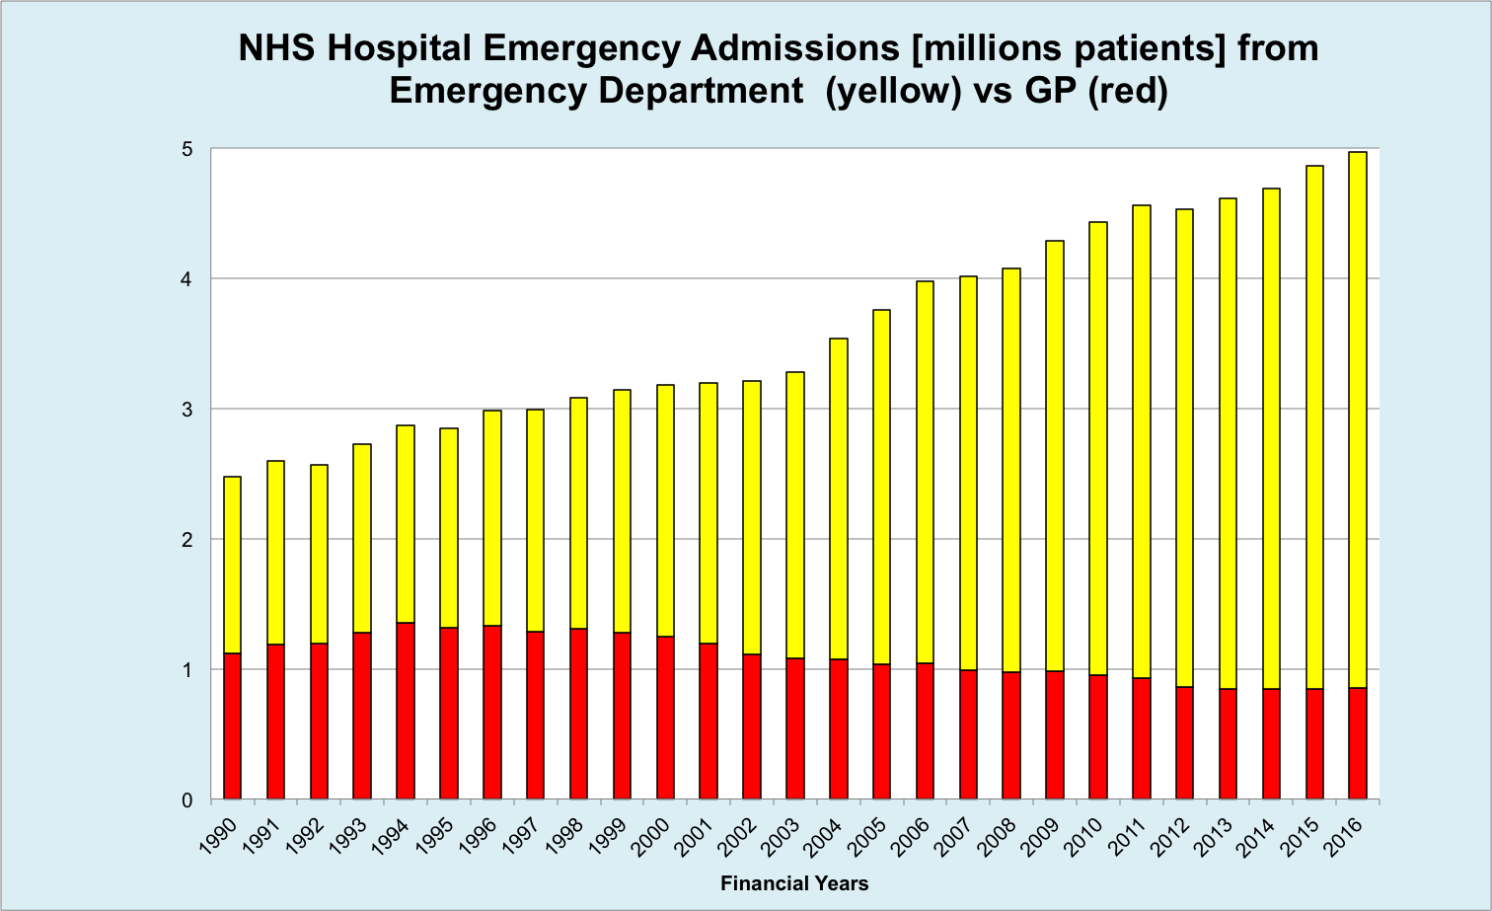

Slide 17
Knock-on effect of SDEC for patients admitted from Type 1 A&E
This graph illustrates how increasing SDEC activity affects average time spent in A&E for admitted non-SDEC patients.
*Patients with an amenable condition, arriving during core AEC unit operating hours

Slide 18
1.30. Under this Long Term Plan, every acute hospital with a type 1 A&E department will move to a comprehensive model of Same Day Emergency Care. This will increase the proportion of acute admissions discharged on the day of attendance from a fifth to a third
SDEC patients = 22% of all acute admissions
Moving from ‘a fifth to a third’ = 13 % absolute increase
= 4% reduction in bed occupancy
£1.1 billion
(16% ED, 6% direct)
= 782,600 fewer stays

Slide 20
Shortlisted priority SDEC pathways for all Trusts to deliver
Pathway * = CQUIN ≅ £500k per trust pa | Category
Community acquired pneumonia* | Respiratory/ CQUIN
Atrial fibrillation* | CQUIN
Pulmonary embolis (PE)* | CQUIN
Cellulitis
Right upper quadrant pain or abscess | Surgical
Acute Kidney Injury (AKI) | Renal
Falls (no injury) | Frailty
Chest pain (low risk)
Hyperemesis | Gynaecology
Pyelonephritis | Renal
Paediatric Asthma | Paediatrics
Methodology
The pathways have been shortlisted using the following methodology:
3 are incentivised CQUIN pathways
Recommended by subject area experts during the SDEC workshops
Rationale
The pathways were all shortlisted using the following rationale:
High volume pathways with the potential to make a significant impact on A&E/ED
Involve a mix of speciality engagement
Covers a range of age groups
Covers a range of system pathways (e.g. some will require need community engagement, internal Trust diagnostics etc.)
Distributes the patient journey to allow them to go to other units
Together the pathways encompass a whole system review
Clear in terms of coding so clearly identifiable
20

Slide 21
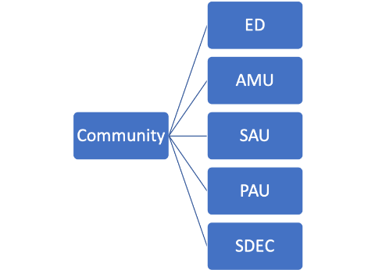
Change of mind-set…..
Community
ED
Ward
Home

Slide 22
Enhanced Health in Care Homes

Slide 23
Enhanced Health in Care Homes

Slide 24
EHCH - Once for London programme
Supporting delivery of the Enhanced Health in Care Homes framework across the London region via specific once for London projects alongside supporting improvement via shared good practice.
Facilitation of the NHS Pharmacy Integration Funding allocation to 5 STPs across London
Support development of robust plans to delivery of MOCH across 5 areas.
Lessons learnt from 17/18 Flu campaign
Comprehensive Flu campaign for 18/19 supported by PHE and ADASS.
Influenza SOP for OOH Outbreaks
NHS 111 *6
Enhanced
Primary Care
Medication Optimisation
Flu Planning 18/19
Digital
Workforce
Training & Development
PAN LONDON PRIORITIES
EHCH Faculty
Enhanced
health in
care homes
Nutrition and Hydration
Reviewing current models in place across London
Support development of standards framework to support primary care services for care homes
Using CarePulse to measure Care Home Capacity across London
Using the Care Home Digital Exemplar programme to accelerate early adoption of digital tools to support discharges and reduced length of stay.
Support care homes through the DSP toolkit with a partnership approach across NHS Digital partners
Raise awareness of Tech Enabled Care via collaborative workshops.
Help to prime the system to support use of NHS mail to communicate with care homes .
Once for London Care Home Task and Finish Groups
Transfers of care to care homes
Care Home Trusted Assessor
Expected deaths in the Community
Significant 7 Training in Care Homes
What’s best for Lily End of Life care training for care home staff
TBC Hydration
24

Slide 25
Enhanced Health in Care Homes
Enhanced Primary Care Support Access to consistent, named GP and wider primary care services Medicine reviews Hydration and nutrition support Access to out of hours/urgent care
Multidisciplinary advice and support including health and social care Expert advice and support for those with the most complex needs Helping professionals, carers and those with support needs to navigate
Re-ablement and rehabilitation Aligned rehabilitation and reablement services Developing community assets to support resilience and independence
High quality end of life care and dementia care
Joined up commissioning and collaboration Co-production with providers and networked care homes Shared contractual mechanisms Access to appropriate housing options
Workforce Development Training and development for care staff Joint workforce planning
Data, IT and technology Linked health and social care data sets Access to the care record and secure email
25

Slide 26
Significant 7
Significant 7 training and tools have been designed to help Care Home staff identify deteriorating residents, improve communications within the home and take appropriate action to meet each individual’s needs.
Evaluation of previous projects identified…
Reduction in Emergency Department admissions by 31% in care homes and 50% in special sheltered accommodation
Reduction in falls by 17%
Reduction in pressure ulcers by 23%
Significant 7 has been designed by the North East London Foundation Trust (NELFT) and BHR CCG teams

Slide 27
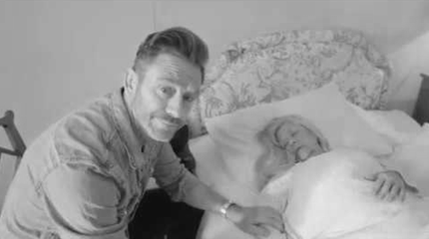
End of Life Care in a care home - What’s best for Lily?
London has:
Fewer deaths in care homes (14.9% vs. 22.4% across England)
More deaths in hospital (52.5% vs. 46.0% across England)
Fewer deaths in usual place of residence (38.0% v. 46.0% across England)
UCLPartners (Academic Health Science Network) have been commissioned by Health Education England to develop and deliver What’s best for Lily? Free innovative educational resources specifically designed for care home staff. To help staff provide high quality care and support to residents in their final weeks of life, meeting CQC standards
Care homes can choose from the following training topics:
Supporting loved ones and advocating for dying resident
Care in the last days of life
Recognise and use Lily symbol when a resident is dying
Looking after ourselves after death of a resident

Slide 28
Expected Death in the community
What?:
A multi-agency group consisting of partners including the police, coroners office, 111 services, LAS and the End of Life Clinical Leadership Group are working together to identify the challenges and solutions.
What do we hope to achieve?
Increased awareness of processes and systems in place to support expected deaths
Support care homes to be confident in accepting 7/7 discharges from hospital with clear supported processes and consistent documentation
Reduce the need for the involvement of police and coroners for these cases therefore reducing unnecessary distress for carers and families. And better utilisation of resources.
28
Notes:
Recent case studies identify there are system failures that can result in expected deaths being considered as suspicious/unexpected leading to the involvement of police, coroners, delays in transfer to funeral directors, distress to family and the subsequent unnecessary allocation of resources.
It has also been identified that care homes have specific concerns about accepting hospital discharges over the weekend, resulting in extended length of stays for patients in acute beds, due to concerns about the process that needs to be followed if the patent subsequently dies without having been seen by a GP and a belief this requires designation as an unexpected death leading to involvement of police and coroners.
The working group will review current processes and responsibilities relating to expected deaths in the community, identify variances and root causes which are likely to include both misinterpretation of guidance and a specific educational component required for all partners involved in the pathways along with current ambiguity in terms of where roles and responsibilities are aligned.

Slide 29
Significant 7
Significant 7 training and tools have been designed to help Care Home staff identify deteriorating residents, improve communications within the home and take appropriate action to meet each individual’s needs.
Evaluation of previous projects identified…
Reduction in Emergency Department admissions by 31% in care homes and 50% in special sheltered accommodation
Reduction in falls by 17%
Reduction in pressure ulcers by 23%
Significant 7 has been designed by the North East London Foundation Trust (NELFT) and BHR CCG teams

Slide 30
High Intensity Users

Slide 31
All the work we do with our partners moves us closer towards our goal to make London the healthiest global city.
www.healthylondon.org
england.healthylondon@nhs.net
@healthyLDN

