Slide 1
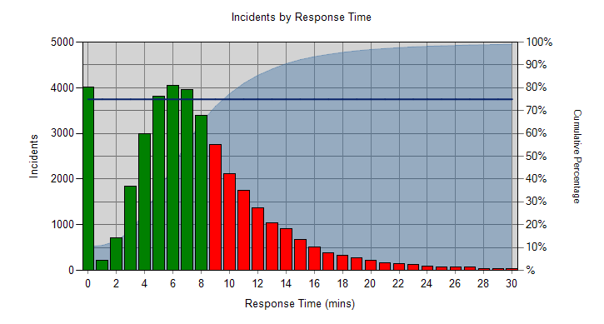
Current LAS Performance
LAS Commissioning Weekly Update
1st May 2015
 | Category A |  |  | Red 1 |  | Red 2
Week to date figures for 2404/15 – 30/04/15 | Incidents | % reached in 8 mins | % reached in 19 mins | Incidents | % reached in 8 mins | Incidents | % reached in 8 mins
LAS Total | 9083 | 66.08% | 94.22% | 251 | 66.14% | 8832 | 66.08%
LAS Cat A weekly performance is currently 66.08% and YTD performance is 64.80% , which is an improvement on last week’s YTD performance of 64.36%. This week’s CAT A19 performance is currently 94.22% and YTD performance is 94.26%. LAS continue to save a number of ambulance attendances through the use of the Clinical Hub, with a total of 3,052 dispositions not needing an ambulance last week. The Trust remains at REAP level 4.
The “Cat A performance tail” is monitored as an indicator of safety during periods of underperformance. Using the diagram opposite, LAS achievement against the 75% target is within 10 minutes and 95% within 18 minutes (YTD). This is on par with last week’s performance.

Slide 2
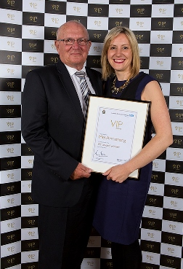
LAS Updates
‘Angel’ paramedic recognised for saving man’s life
A London Ambulance Service paramedic, dubbed a ‘guardian angel’, has won an award
for bringing a man back to life while on a family holiday.
Mel Armstrong, 34, was on Brighton Pier with her husband and two children on New Year’s Eve when she saw a man collapse at the slot machines.
She said: “I heard a loud bang and I turned around and there was a man slumped against a machine. As I looked down, I could tell instantly he was about to stop breathing. I did CPR and after a few minutes managed to get a pulse back.”
Mel cared for the patient, Brian Smith, until an ambulance crew arrived and took him to hospital, leaving Mel not knowing if he had lived or died.
By sheer coincidence, Brian’s nephew Mark House, works as a clinical team leader for London Ambulance Service, and got word to Mel that his uncle had survived and was out of hospital and was incredibly grateful to her for saving his life.
Brian, 72, from Cheam, Surrey, said: “If it hadn’t been for Mel, I wouldn’t be sitting here. She’s my guardian angel. It was my lucky day that she was there. She didn’t have to do what she did – she could have walked on, but she stepped up to the plate.”
Mel, who has worked for the Service for 12 years and lives in Essex, added: “There were hundreds of people watching what was going on and as I left quite a few said ‘well done’ and shook my hand. I believe I was meant to be there that day and since meeting Brian, we just clicked and have formed a strong bond.”
30th April 2015
Source: London Ambulance Service

Slide 3
LAS Reports
LAS in the Media
* Please click and download below the latest LAS exception report
London’s emergency services experience telecoms failure
The telephone communication systems used by the police, fire and ambulance services in London failed earlier, it has emerged.
The secure system, known as Airwave, helps emergency services to communicate. It failed from 09:00 to 09:40 BST, the BBC's Danny Shaw said.
Airwave Solutions Ltd has confirmed there was "an issue with intermittent communications".
The Met Police said the problem was believed to have been a power failure.
London Ambulance Service said it lost Airwave for less than 40 minutes and the impact on operations was minimal.
A spokesman for the Metropolitan Police service: "Maintaining our service to the public and officer safety were our first considerations during the outage period, and measures were put in place to ensure it was maintained."
It said Airwave was putting measures in place to avoid any repeat of the problem.
"We were very lucky to avoid anything too bad," a police source told the BBC.
28th April 2015
Read more here: http://www.bbc.co.uk/news/uk-england-london-32500431
Source: BBC News

Slide 4
Team Contacts
Elizabeth Ogunoye | Team Director | 0203 350 4219 | elizabeth.ogunoye@nw.london.nhs.uk
Katy Neal | Head of Performance | 0203 350 4229 | katy.neal@nw.london.nhs.uk
David Whale | LAS Contract Performance Manager | 0203 350 4053 | david.whale@nw.london.nhs.uk
Julian Williams | Directory of Service Lead | 0203 350 4605 | julian.williams@nw.london.nhs.uk
Stephanie Grant | Product specialist 111 /OOH/UCC contracts | 0203 350 4171 | stephanie.grant@nw.london.nhs.uk
Mayarun Begum | Project Officer | 0203 350 4752 | mayarun.begum@nw.london.nhs.uk
William Sheppard | Administration Support Officer 111/OOH/UCC | 0203 350 4174 | william.dunbar-sheppard@nw.london.nhs.uk
Eleanor Campbell | LAS Administration Support Officer | 0203 350 4187 | Eleanor.Campbell@nw.london.nhs.uk
Daniel Gadd | Directory of Service Administration Support Officer | 0203 350 4401 | Daniel.Gadd@nw.london.nhs.uk
Lucy Olliff | Directory of Service Administration Support Officer | 0203 350 4206 | Lucy.Olliff@nw.london.nhs.uk

