Slide 1
Delivering Safe and Effective Emergency and Urgent Care in London
Paul Woodrow
Director of Operations
Patients’ Forum – 10 April 2017

Slide 2
Year end performance position
Performance standard | % Target | % Actual
Call Answering 5 secs | 95.0% | 95.4% (+0.4%)
Category A | 67.6% | 66.4% (-1.2%)
Red 1 | 71.1% | 69.2% (-1.9%)
Red 2 | 67.5% | 66.3% (-1.2%)
A19 | 93.0% | 93.5% (+0.5%)

Slide 3
Strong end to the FY
During March, we reached 73.47% of Category A patients in eight minutes compared to 58.24% in March 2016 and above our agreed month end targets with our commissioners
During March Red 1 Performance achieved 74.9% in eight minutes compared 66.3% in March 2016
During March Red 2 Performance achieved 73.4% in eight minutes compared to 58.0% in March 2016

Slide 4
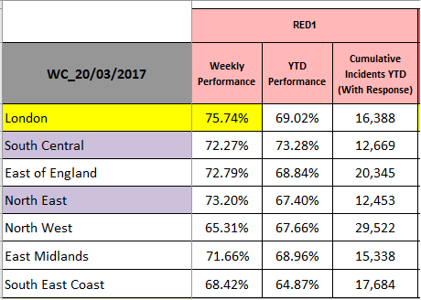
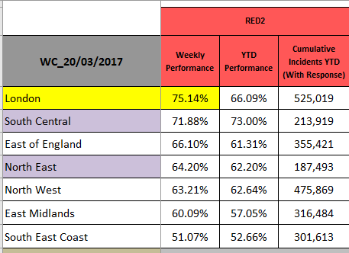
National Benchmarking

Slide 5
Performance

Slide 6
Demand

Slide 7
Capacity

Slide 8
Job cycle time

Slide 9
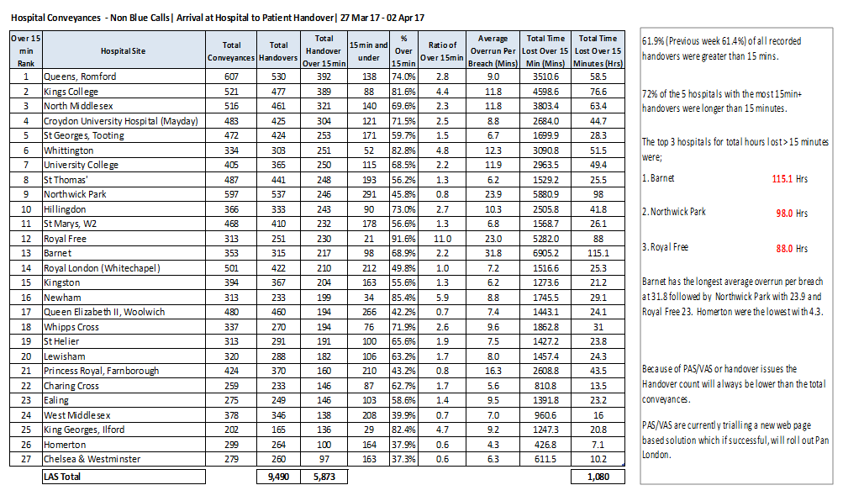
Hospital conveyance

Slide 10
Other Achievements
80% of operational frontline staff received a Personal Development Review versus 8% in 15/16
Over 90% of operational staff completed CSR modules 1,2&3 during 16/17
NHS111 service in SE London was rated as good by CQC
Improved results from last years staff survey
Still lots to do though……………..

Slide 11
Operational objectives 17/18
We will reduce job cycle time by 7 minutes by 31 October so that our sickest patients are treated at the most appropriate setting of care as quickly as possible
We will maximise operational efficiency by reducing inappropriate multiple attendance ratios to 1.2 by 31 October so that we make best use of available resources
By the end of May, we will have agreed the plan for a Trust wide roster review for implementation by March 2018.

Slide 12
Operational objectives 17/18
In July 2017 we will implement new Rest Break and end of shift arrangements
By June 2017, we will co-design demand management initiatives across London, throughout the year we will support delivery of those initiatives
By September, we will introduce 5 new operational placement centres to support the induction and operational supervision of our new frontline staff.

Slide 13
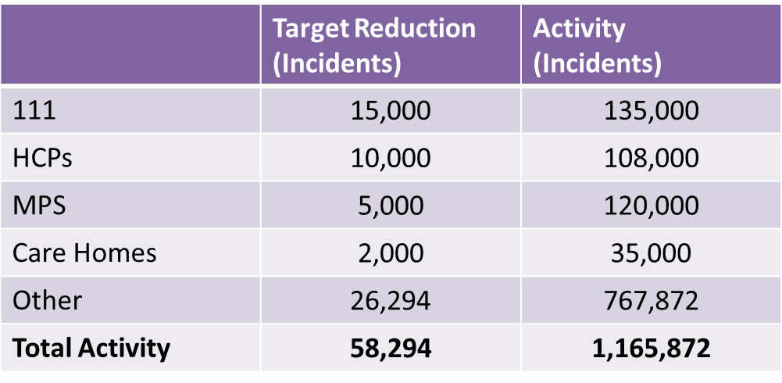
Demand management opportunities

Slide 14
Summary
LAS is reaching its sickest patients sooner
Demand is the Trust’s main challenge but we are working closely with our CCG commissioners to reduce this
The Trust needs to be more efficient and we have plans to reduce our job cycle time and multiple attendance ratio between now and October
In order to improve our capacity, we are undertaking a roster review during 2017/18 and implementing new rest break and end of shift arrangements.

