Slide 1
Chief Quality Officer Developing Safer, Higher Quality Care for Patients
Patients Forum : 13th February 2017

Slide 2
Development of the CQO role in NHS
Why this role was felt to add value to NHS generally
What my role will bring
Areas of focus over the coming months
How do we add to the great work already achieved in patient engagement?

Slide 3
Managing quality is difficult...
Growing complexity of care
Challenge of improving productivity
Increasing demand and expectations
Lack of coordinated approach to domains of quality
Effectiveness
Safety
Experience

Slide 4
Quality as important as finance
Financial management needs an Executive Director on the Board
and a non-Exec Director with financial expertise
So why doesn’t quality management receive same attention?

Slide 5
The case for a Chief Quality Officer
Quality remains ‘everybody’s business’
Just as responsibility for good financial management is ‘everybody’s business’ despite a Director of Finance
Doesn’t absolve other Board members from sharing responsibility and CEO/Chair ultimately responsible
CQO work closely with other Board members
Particularly medical and nursing directors
Overcomes potential conflicts of interest between quality and medical/nursing priorities
Common in the USA

Slide 6
Scope of role
Leadership, vision, inspiration and oversight of quality
Accountable to Board for the assessment and the improvement of quality
Share corporate responsibilities
Possess expertise in quality management
Technical/scientific aspects
Behavioural/organisational aspects
National policy developments

Slide 7
Six main functions
Ensure activities across all three domains of quality are coordinated
Establish scientifically rigorous quality assessment throughout the Trust
Lead development and implementation of quality improvement throughout the Trust
Relationships with external agencies
related to quality initiatives
Patients/public, Commissioners, ‘Regions’ (AHSN, LETB, QSG), CQC,Regulators, Risk management, etc

Slide 8
5. Ensure education and training in quality management for clinical and non-clinical staff
6. Managerial responsibilities
Director of quality ‘department’; provide leadership for: integrated quality, safety and risk function
Develop strategy & manage quality improvement programmes
Involve public/patients/external stakeholders in quality management
Measure, review and inform about Trust’s quality performance

Slide 9
Role connection
Quality Triumvarate
Medial Director , CQO and Director of Operations– work collaboratively across the quality improvement agenda closely with Director of Transformation and Strategy
Consultant/ Paramedic/AHPs and DoN, ADOs work closely to operationalise the strategies, business partner support
Clear roles and responsibilities
Less duplication of effort
Clear focus on priority areas of work
Supported by strengthened quality governance frameworks
Clear reporting and information frameworks
Sector Business Partners: Quality, BI, HR, Finance
Consultant
Paramedic/
AHPS
Director of Nursing
ADOs/CTL
Patient and Staff
Involvement
Medical Director
CQO
Director of
Operations

Slide 10
Integration, collaboration and co-ordination
Thematic integrated functions
Inter-grated business partner functions both within the Quality, Operational and Medical Directorate and between the Sectors
Clearly defined and standardised roles and responsibilities with appropriate resource
Alignment to Trust and local objectives
Prioritised programmes aligned to strategies and transformation agenda
Support, training and development in QI and Governance
Sector Business Partners
Patient
Exp/PPI
Patient Safety
Nursing/Medical Leadership and Team Development
Quality Intelligence, Learning,
Improvement
Governance & Risk Teams
Integrated Quality & Safety Function
CARU
Sector QGAMS
Quality Improvement & Development
Integrated Quality Management Function

Slide 11
Model for Improvement
What are we trying to
accomplish?
How will we know that a
change is an improvement?
What change can we make that
will result in improvement?
Act
Plan
Study
Do
The Improvement Guide, API
Notes:
11
Data and measurement is core to the model for improvement. You can’t run an improvement project without using data.
You need to use data in PDSAs – when planning you need to plan what data and how to collect it.
Doing, you must collect the data.
Studying, study the data collected.
Act on what the data is telling you.
Think about what are the components that are needed when presenting data for improvement. 5 minutes in pairs to discuss then report back.

Slide 12
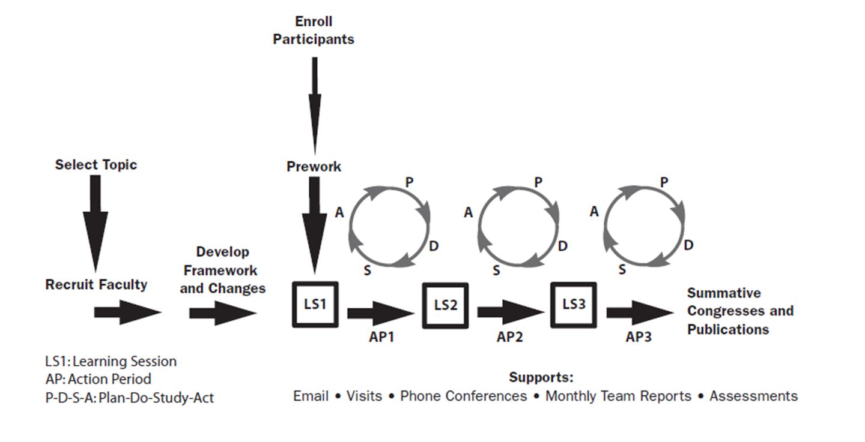
Agreed Improvement Methodology: utilising driver diagrams and embedding learning
IHI: Breakthrough Collaborative Methodology

Slide 13
AIM
PRIMARY DRIVERS
SECONDARY DRIVERS
System components that “drive” the aim
If they are in place, the aim will happen
System components that “drive” the Primary
If they are in place, the primary will happen
Launch events roadshows
Build the will
Aiming for
GREAT
Network/champions
Learning events
Build Improvement capability
Recruit central QI team
Training methods
Coaching on projects
Align to improvement/strategic aims
Alignment
Embed within management structures
Align corporate support systems
QI /Recovery
Projects
Reducing harm
Right care, right place, right time
System wide strategic improvements
Notes:
Set out like this
There will be some overlap with your objectives too.
JC notes:
Considerable overlap with objectives.

Slide 14
CQO – review of portfolio and systems and processes
 | January | February | March | April | May
Review 1 New structures, roles, costs |  | Agree new structures |  | Agree implementation & Business case
Review 2: Quality and Safety Systems and process review: develop quality strategy
Review 3: Business Partner /Ext Partner /Imp & Engagement Models
Review 4: Quality Governance & Clinical Gov committees
Review 5: Quality Reporting
Final Presentation
ID team & roles
31
Share structures Board
29
Implementation
1
28
ELT
15
ELT
5
Need to understand timeline and changes
Rapid Review
22
Approval at Executive
28
Approval at LAS Board
t
30
xpected date of Agreement
ELT Review
I
29
22
Approval at LAS Board i
29
Approval at Board
Completion by 29 March
Approval at QGC
22
29
Approval at Board
Completion by 29 March
Approval at Executive
Approval at Board
Present final report
29
Implementation
TODAY, 24/01/2017
DRAFT FOR DISCUSSION
14

Slide 15
Outcome : High Quality, Safer Care
Motivated, capable staff
Reduction in duplicated effort, agile and responsive approach
Prioritised effort- based on risk and impact
Integrated patient safety and quality governance frameworks
Learning, Action and Assurance focused
Improved resource, functionality and efficiency
Business intelligence/partner improvement focused decisions
Trust wide confidence and support for quality outputs
Increased staff and patient engagement in quality agenda

