Slide 1
Commissioning of London Ambulance Service LAS Patient’s Forum
Mark Docherty
8th July 2013

Slide 2
The session will cover briefly
Contract and cost
LAS Response Model
Activity changes
Performance
Benchmark Comparators
Modernisation
Collaborative commissioning going forward

Slide 3
Contract & Cost

Slide 4
The Contract
Operating Framework 2011/12 required ambulance contracts to be ‘Payment by Results’
LAS contract activity based, but ‘blocked back’
Risk Share during year, but re-based each year
Most of the cost is based on activity
Some ‘fixed cost’ (Hazardous Area Response Team £6.45m – apportioned by population)
Total contract value for LAS - £269.7m

Slide 5
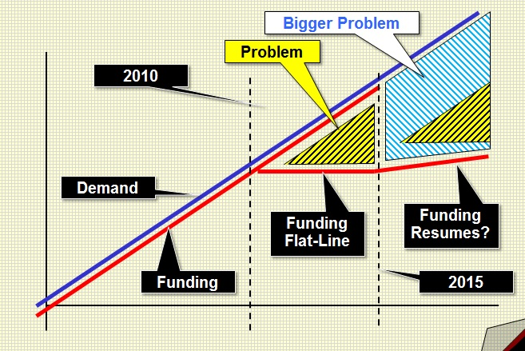
The Financial Context

Slide 6
Intelligent Response Model

Slide 7
How do LAS manage a 999 call?
Throughout London there are key points where LAS have vehicles on standby.
e.g. Enfield has an essential location point (see right)
When a call is received the dispatch system will automatically look for the nearest vehicle to respond.
Ambulance stations now are locations for staff to start and finish shifts.

Slide 8
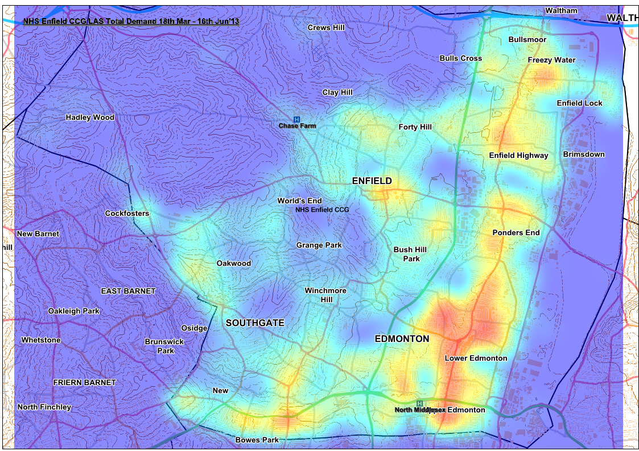
Demand Maps
Slide content
Sub bullets
Sub bullets

Slide 9
999 Call
AMPDS Categorisation
Cat A
Cat C
Dispatch
999 Resource
Triage
999/111 Resource
Ambulance Response
Single Practitioner Response
Referral to:
GP
Community Facility
A&E
Emergency
Self Care
Patient Assessment
(& Treatment)
Transport
End of Episode
End of Episode
Secondary Care
Specialist Department
A&E
End of Episode

Slide 10
Activity & Performance

Slide 11
999 Call Activity

Slide 12
Category A (Red 1 & 2) Activity

Slide 13
Category A Performance

Slide 14
Category C (Green 1 – 4) Activity

Slide 15
Ambulance Demand Challenges for London

Slide 16
LAS Benchmarking

Slide 17
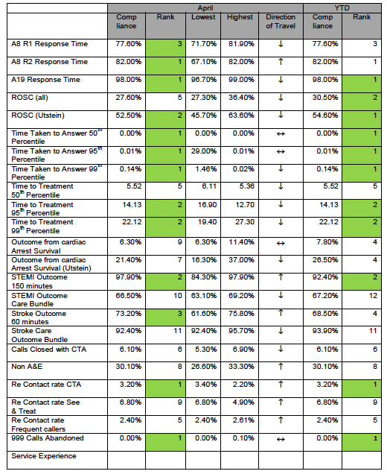

Slide 18
Non-Conveyance rates across England (12/13)

Slide 19
Modernisation

Slide 20
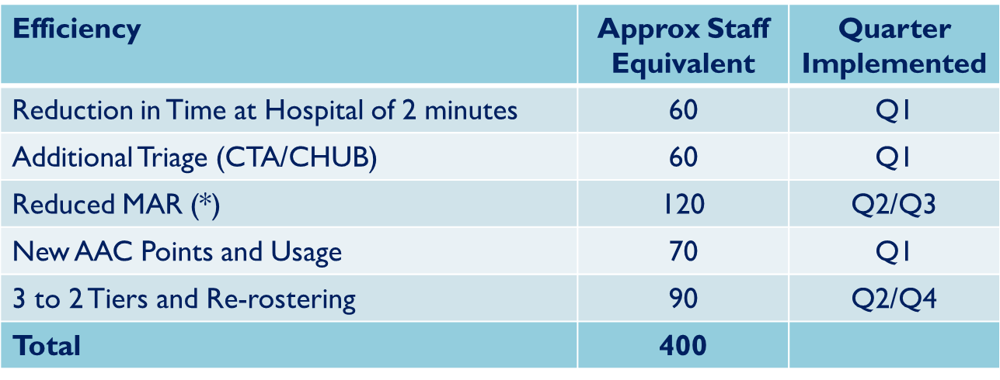
LAS Efficiencies
MAR = Multiple Attendance Ratio (Number of Vehicles that attend an incident)
AAC = Active Area Cover
CTA = Clinical Telephone Advice

Slide 21
Collaborative Commissioning

Slide 22
CCG Engagement in Collaborative
Transactional Contracting
Activity
Commissioning
Commissioning Strategy
Clinical Quality
Risk
Finance
Performance
Patient Experience
Quality
Contract

Slide 23
Collaborative Commissioning Structure
Transactional Contracting
Ambulance Commissioning
CCG Urgent Care Board
Pan-London
Health Economy
Local Ambulance Commissioning Group
CCG Urgent Care Board
Local Ambulance Commissioning Group
Task & Finish Group
Clinical Quality
CCG Executive
Pan-London
Contract Management Board

Slide 24
mark.docherty@nw.london.nhs.uk

