Slide 1
Patient Forum Pack
March 2018
LAS Performance Pack
This report refers to February 2018 Data unless otherwise stated
This data is subject to change

Slide 2
EXECUTIVE SUMMARY
Ambulance Response Programme – Definition & Overview
Since February 2015, three other ambulance services - South West, Yorkshire and West Midlands - have been involved in trials led by NHS England of the new standards. They focused on four main areas:
Identifying the most seriously ill patients as early as possible through processes known as Pre-Triage Sieve and Nature of Call.
Giving control room staff more time (up to 240 seconds) to assess incidents through a process known as Dispatch on Disposition.
Developing new clinical code sets and response categories using the best available clinical evidence.
Developing new targets, indicators and measures.
The trials have also been independently reviewed by the University of Sheffield.
Category | Percentage of calls per Category | National Standard | How long does the ambulance service have to make a decision? | What stops the clock?
Category 1 | 8% | 7 minutes mean response time 15 minutes 90th centile response time | The earliest of: The problem being identified An ambulance response being dispatched 30 seconds from the call being connected | The first emergency vehicle that arrives on scene stops the clock.(There is an additional Category 1 transport standard to ensure that these patients also receive early ambulance transportation)
Category 2 | 48% | 18 minutes mean response time 40 minutes 90th centile response time | The earliest of: The problem being identified An ambulance response being dispatched 240 seconds from the call being connected | If a patient is transported by an emergency vehicle, only the arrival of the transporting vehicle stops the clock. If the patient does not need transport, the first emergency vehicle arriving at the scene of the incident stops the clock.
Category 3 | 34% | 120 minutes 90th centile response time | The earliest of: The problem being identified An ambulance response being dispatched 240 seconds from the call being connected | If a patient is transported by an emergency vehicle, only the arrival of the transporting vehicle stops the clock. If the patient does not need transport, the first emergency vehicle arriving at the scene of the incident stops the clock.
Category 4 | 10% | 180 minutes 90th centile response time | The earliest of: The problem being identified An ambulance response being dispatched 240 seconds from the call being connected | Category 4T: If a patient is transported by an emergency vehicle, only the arrival of the transporting vehicle stops the clock.
The new standards are intended to:
Prioritise the sickest patients quickly to ensure they receive the fastest response
Ensure national response targets to apply to every patient for the first time – so ending ‘hidden waits’ for patients in lower categories
Ensure more equitable response for patients across the call categories
Improve care for stroke and heart attack patients through sending the right resource first time.
Due to the nature and impact of these changes, the previous performance measures are not comparable.
However, NHS England have published National Standard for a number of the key measures which are included here.

Slide 3
EXECUTIVE SUMMARY
Ambulance Response Programme – Performance Summary
 | C1 Mean (00:07:00) | C1 90th Centile (00:15:00) | C2 Mean (00:18:00) | C2 90th Centile (00:40:00) | C3 90th Centile (02:00:00) | C4 90th Centile (03:00:00)
Last month (Feb 18) _ | 00:07:28 | 00:11:48 | 00:23:21 | 00:49:20 | 02:59:18 | 02:34:17
Previous month (Jan 18) _ | 00:07:08 | 00:11:43 | 00:20:23 | 00:42:05 | 02:24:59 | 02:19:05
Current YTD (2017/18) *_ * from 1st November 2017 | 00:07:18 | 00:11:51 | 00:22:02 | 00:46:10 | 02:40:30 | 02:36:02
Demand
Performance
86,296 Incidents were provided with a face-to-face response.
Category 2 incidents reached 48,695 incidents. This accounts for 59% of face-to-face responses.
7,772 incidents were categorised as Category 1 and provided with a face-to-face response.
The Mean response time for C1 was 7 minutes 28 seconds. This is a marginal increase when compared to the previous month.
The C1 90th Centile was 11 minutes 48 seconds. This has remained within the 15 minute national standard each week since the implementation of ARP.
The Mean response time for C2 was 23 minutes 21 seconds, this is above the 18 minute national standard.

Slide 4
Performance Overview
Demand by Category
Fig 2.1
Fig 2.3
Fig 2.2
Fig 2.4

Slide 5
Performance Overview Key Metric Variance February 2018
Category | Measure | LAS Monthly Performance | National Standard | Variance
Category 1 | Mean Response Time_ | 00:07:28 | 7 minutes | 00:00:28
 | 90th centile_ | 00:11:48 | 15 minutes | 00:03:12
Category 2 | Mean Response Time_ | 00:23:21 | 18 minutes | 00:05:21
 | 90th centile_ | 00:49:20 | 40 minutes | 00:09:20
Category 3 | 90th centile_ | 02:59:18 | 120 minutes | 00:59:18
Category 4 | 90th centile_ | 02:34:17 | 180 minutes | 00:25:43

Slide 6
Performance Overview
National Picture January 2018
Fig 4.1 Illustrates the Category 1 Mean Response Performance for Ambulance Trusts across England during January 2018.
Additional information also displayed :
The National Standard (00:07:00)
The average for England (00:08:19).
The ranking position for each Trust *
LAS achieved 7 minutes and 10 seconds for the mean response time for Category 1 patients. This is only marginally above the 7 minute national standard.
LAS ranked fourth when compared to 10 Ambulance Trusts across England. *
LAS also performed within the England average by 1 minute and 9 seconds.
This is the latest officially published data. An update is due on 13th March 2018.
* Isle of Wight not ARP compliant until Spring 2018
Fig. 4.2 Displays the six key ARP performance measures for each Ambulance Trust across England during January 2018.
LAS ranked 3rd in the Category 1 90th centile performance measure, compared to the other Trusts.
For Category 4 90th centile, LAS ranked 1st compared to the other Trusts.
We ranked 4th for all other metrics.
January 2018 | Category 1 | Category 1 |  | Category 2 | Category 2 |  | Category 3 |  | Category 4
National Standard | 00:07:00 | 00:15:00 |  | 00:18:00 | 00:40:00 |  | 02:00:00 |  | 03:00:00
England | 00:08:19 | 00:14:29 |  | 00:26:05 | 00:55:36 |  | 02:28:26 |  | 03:15:32
East Midlands | 00:09:19 | 00:16:44 |  | 00:37:11 | 01:22:15 |  | 03:22:40 |  | 02:48:57
East of England | 00:08:35 | 00:15:25 |  | 00:29:11 | 01:00:49 |  | 03:22:54 |  | 03:52:10
London | 00:07:10 | 00:11:45 |  | 00:20:25 | 00:42:08 |  | 02:25:38 |  | 02:19:04
North East | 00:06:32 | 00:11:22 |  | 00:23:23 | 00:48:58 |  | 03:28:22 |  | 03:09:57
North West | 00:09:51 | 00:16:44 |  | 00:39:59 | 01:31:33 |  | 03:14:16 |  | 03:16:31
South Central | 00:07:04 | 00:12:39 |  | 00:16:30 | 00:33:04 |  | 02:15:14 |  | 03:05:58
South East Coast | 00:07:51 | 00:14:07 |  | 00:16:13 | 00:30:12 |  | 02:23:34 |  | 04:03:04
South Western | 00:09:11 | 00:16:50 |  | 00:29:45 | 01:02:29 |  | 02:28:32 |  | 03:32:37
West Midlands | 00:06:48 | 00:11:44 |  | 00:12:22 | 00:22:26 |  | 01:22:49 |  | 02:25:57
Yorkshire | 00:08:10 | 00:13:56 |  | 00:26:57 | 00:59:30 |  | 02:31:51 |  | 03:45:02
Isle of Wight | - | - |  | - | - |  | - |  | -
Fig 4.2

Slide 7
Performance Overview
Performance by STP
These tables show 6 key performance measures for January and February 2018 profiled by STP.
February performance reflects the impact of the adverse weather experienced across London. This resulted in small increases in response times.
Despite this, all STP areas remained within the 9 minute safety standard for the C1 mean.
The C1 90th Centile remained within the 15 minute national standard across all areas.
C4 90th Centile performed within the 3 hour national standard, in 4 of the 5 STP areas
North East C3 90th centile increased by 47 minutes, from 2 hours 27 minutes to 3 hours 14 minutes.
South West STP C1 mean performance was within the national standard of 7 minutes.
January 2017 STP Position | C1 Mean (00:07:00) | C1 90th Centile (00:15:00) | C2 Mean (00:18:00) | C2 90th Centile (00:40:00) | C3 90th Centile (02:00:00) | C4 90th Centile (03:00:00)
North Central | 00:07:13 | 00:11:48 | 00:21:08 | 00:43:25 | 03:06:36 | 02:32:42
North East | 00:07:14 | 00:11:52 | 00:21:24 | 00:43:41 | 02:27:15 | 02:52:32
North West | 00:06:58 | 00:11:28 | 00:20:10 | 00:41:24 | 02:26:55 | 02:12:23
South East | 00:07:14 | 00:12:08 | 00:19:16 | 00:40:13 | 02:04:46 | 02:00:31
South West ____________________________________________________________________ | 00:07:04 | 00:11:16 | 00:19:51 | 00:41:25 | 02:01:45 | 01:56:58
February 2018 STP Position | C1 Mean (00:07:00) | C1 90th Centile (00:15:00) | C2 Mean (00:18:00) | C2 90th Centile (00:40:00) | C3 90th Centile (02:00:00) | C4 90th Centile (03:00:00)
North Central | 00:07:37 | 00:12:24 | 00:24:31 | 00:51:25 | 03:42:28 | 03:17:46
North East | 00:07:45 | 00:11:50 | 00:25:45 | 00:54:33 | 03:14:55 | 02:49:53
North West | 00:07:34 | 00:11:47 | 00:23:51 | 00:51:18 | 03:12:56 | 02:42:06
South East | 00:07:14 | 00:11:33 | 00:19:55 | 00:40:43 | 02:18:08 | 02:06:48
South West ____________________________________________________________________ | 00:06:55 | 00:11:27 | 00:21:56 | 00:45:05 | 02:36:10 | 02:01:38

Slide 8
Hospital Handover Summary
Hospital Conveyance Lost Hours February 2018
In February a total of 6,199 hours were lost at hospital.
Similar to last month, the most hours were lost at Queens Romford with 765 (12%) hours lost.
Ranking second highest was Hillingdon with 508 (8%) hours lost. Over the last 12 weeks Hillingdon has ranked in the top 8, this is a notable shift.
Northwick Park ranked third highest in with 474 (8%) hours lost.
The above 3 hospitals are responsible for 28% (1,747) of hours lost at hospital, across London in February.
There was a marginal increase in lost hours during the half-term period (12th-18th) but then returned to circa 1,500 hours each week in February.

Slide 9
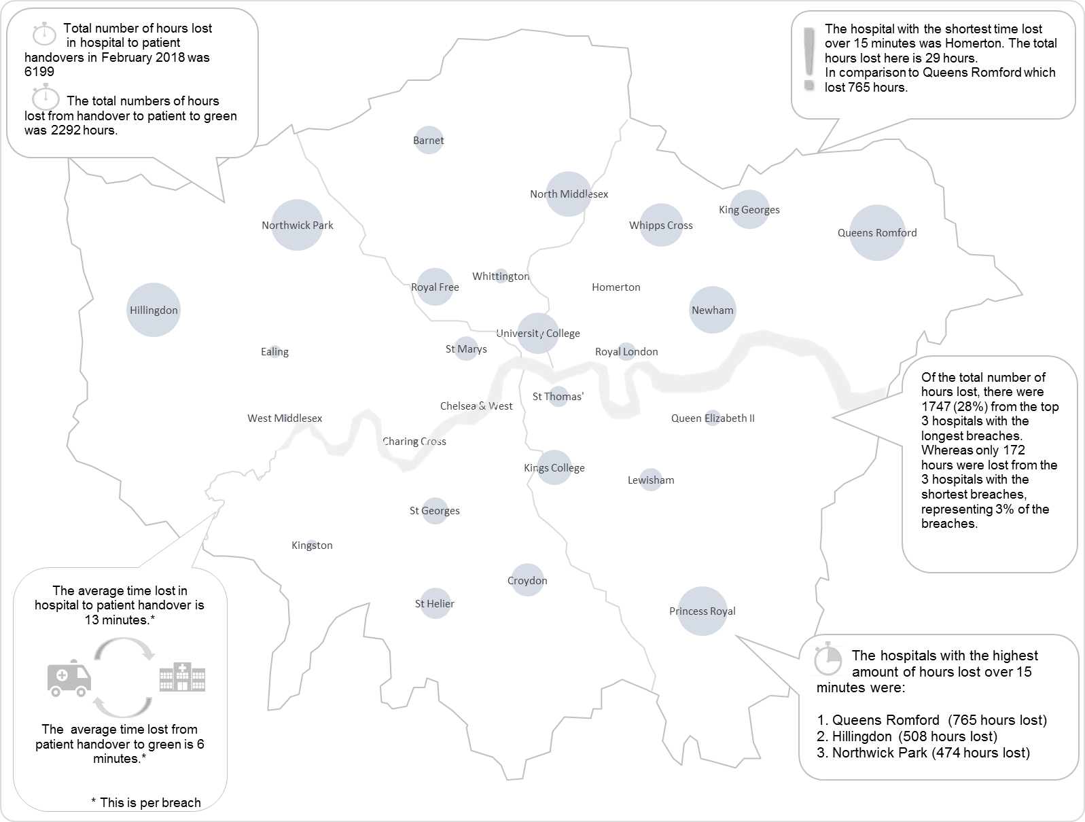
Hospital Handover Summary
Hospital Conveyance by Location February 2018
This map shows the location of each ED hospital across London.
The size of the bubble relates to the comparative hours lost* at that hospital.
The larger the bubble, the more hours lost at hospital.
For example, during the reporting week, the highest hours lost were at Queens Romford.
The fewest hours were lost at Homerton, as the bubble can barely be seen
* Total time accrued after 15 minutes, for arrival at hospital to patient handover.
 | Highest number of hours lost.
 | Lowest number of hours lost.

